Slide 1
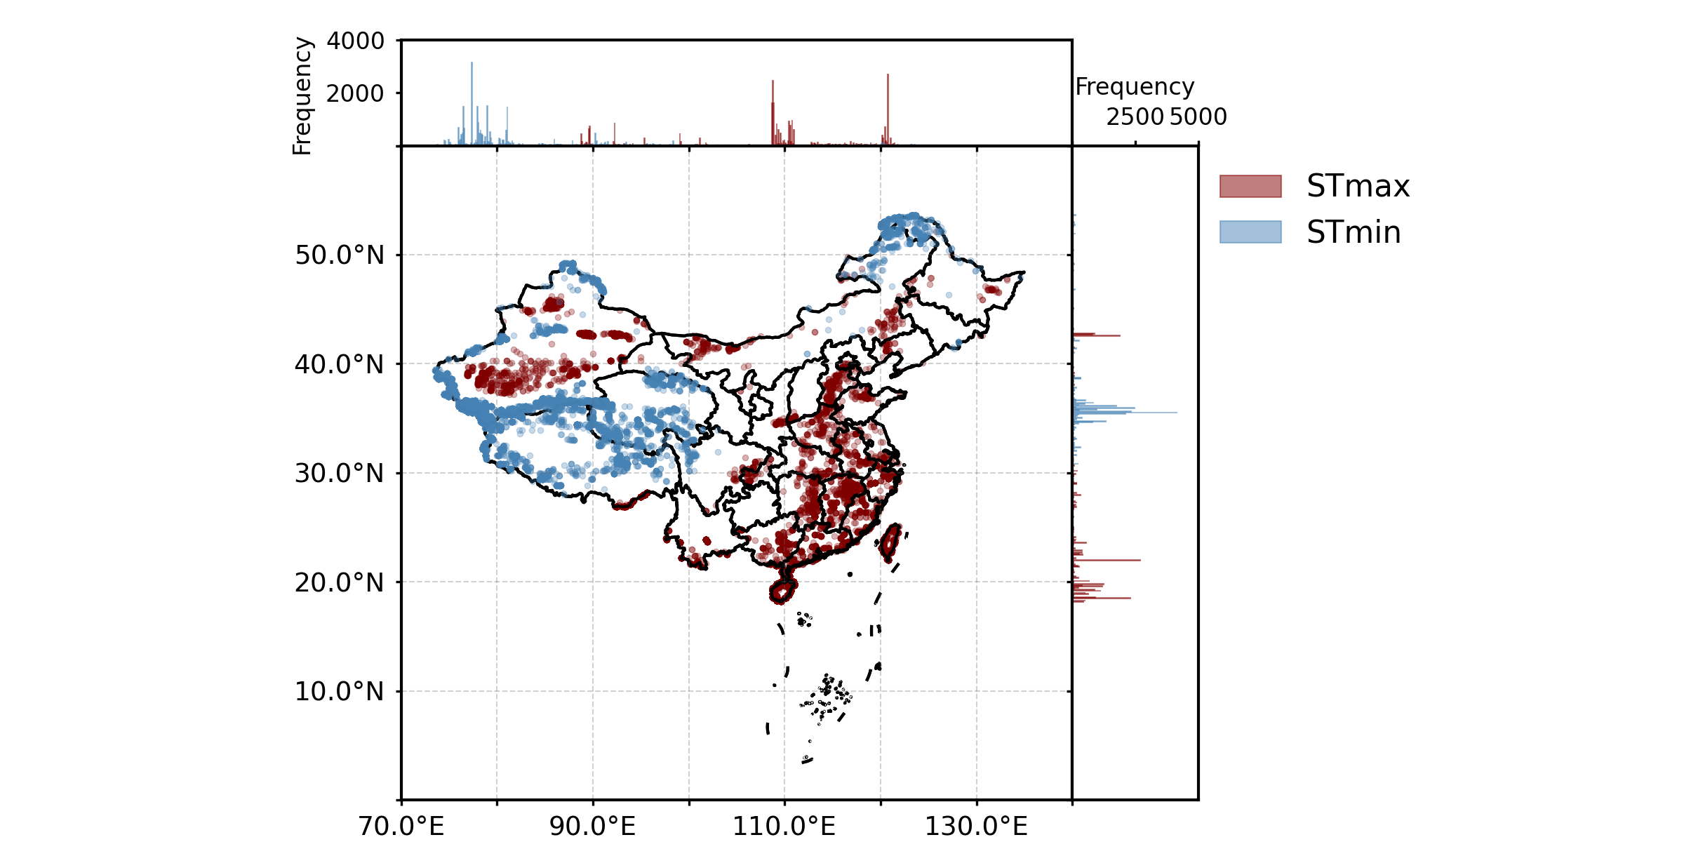


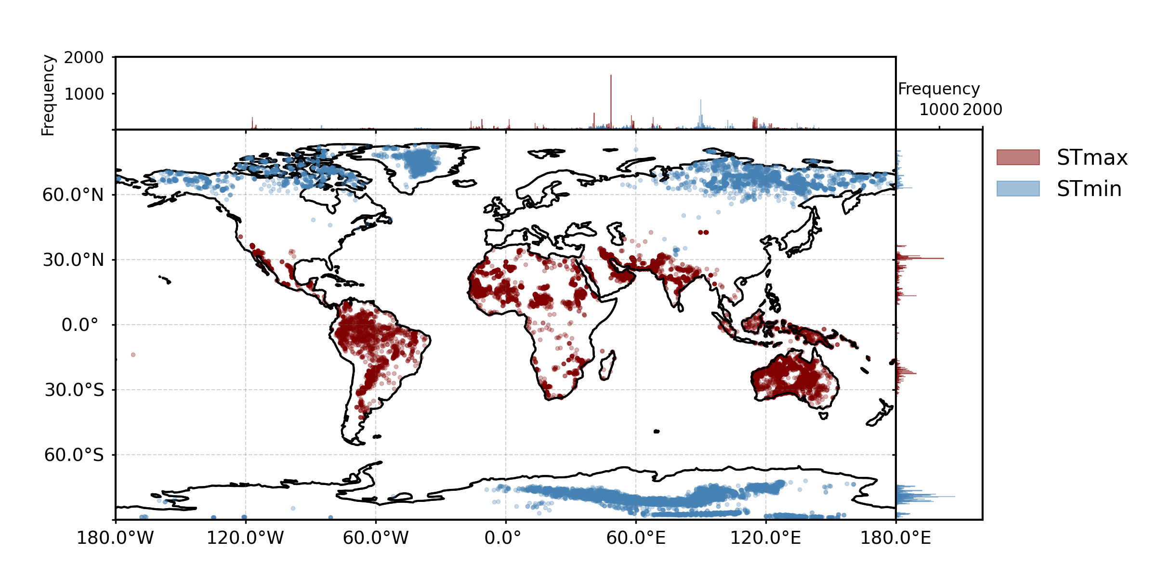
Fig. 2
Original
(a)
(b)
24h per day
HSTR = STmax – STmin
STmax
STmin
DSTR= max(HSTR)
(c)

Slide 2
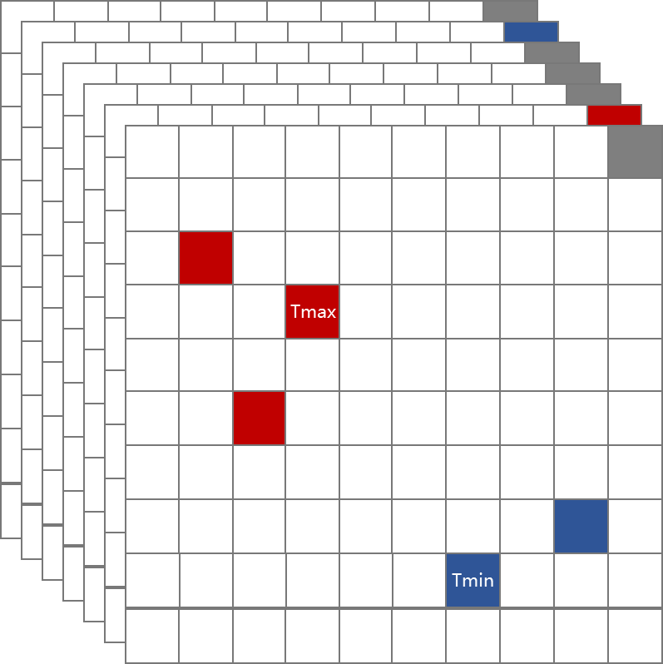
Fig. S1
Temporal
dimension
Tmin
STmax
Tmax
STmin
Spatial
dimension
…
…
…
…
…
…
…
…
…
…
…
Hourly spatial temperature range (HSTR)
DSTR = max(HSTR)
24 hours per day
Diurnal temperature range (DTR)

Slide 3
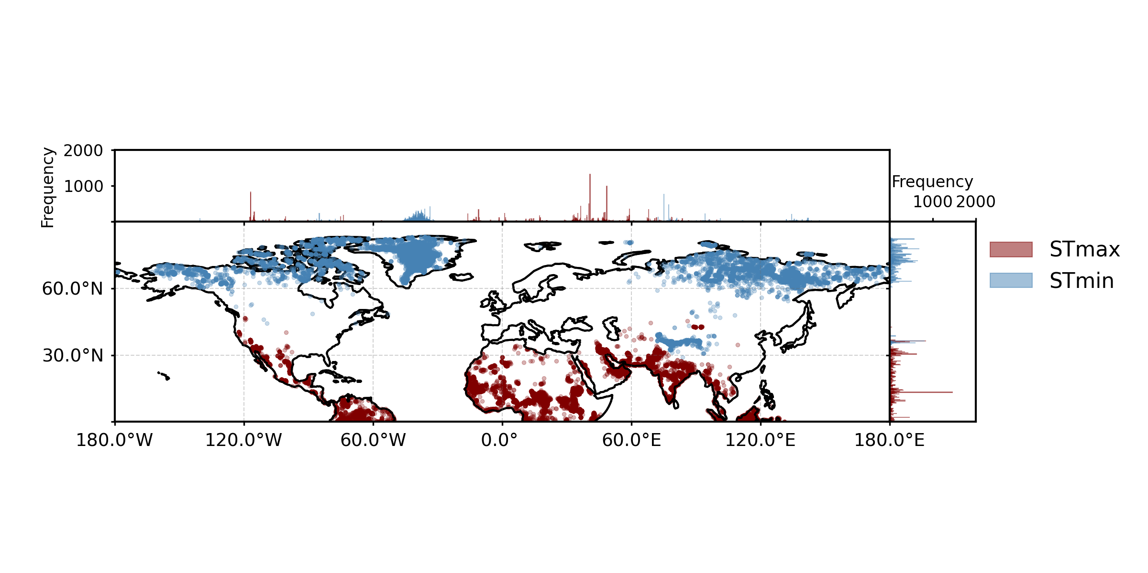
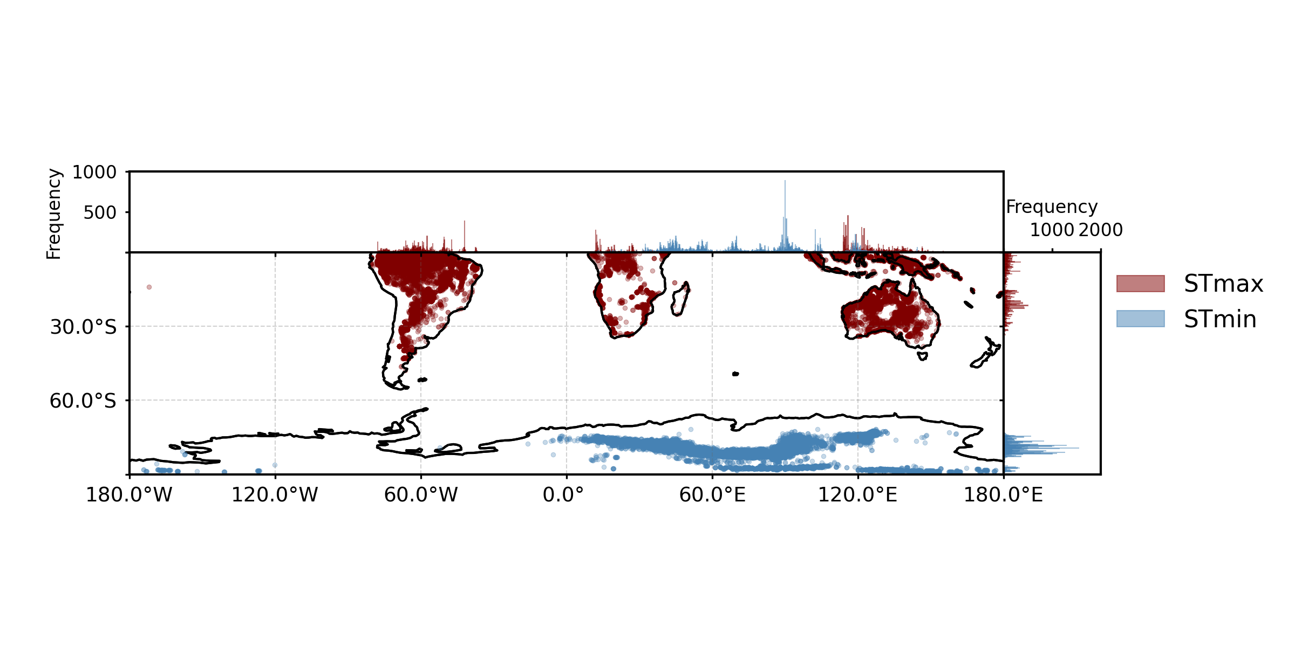
Fig. S2
(a) North hemisphere
(b)
(b) South hemisphere
(c)

Slide 4
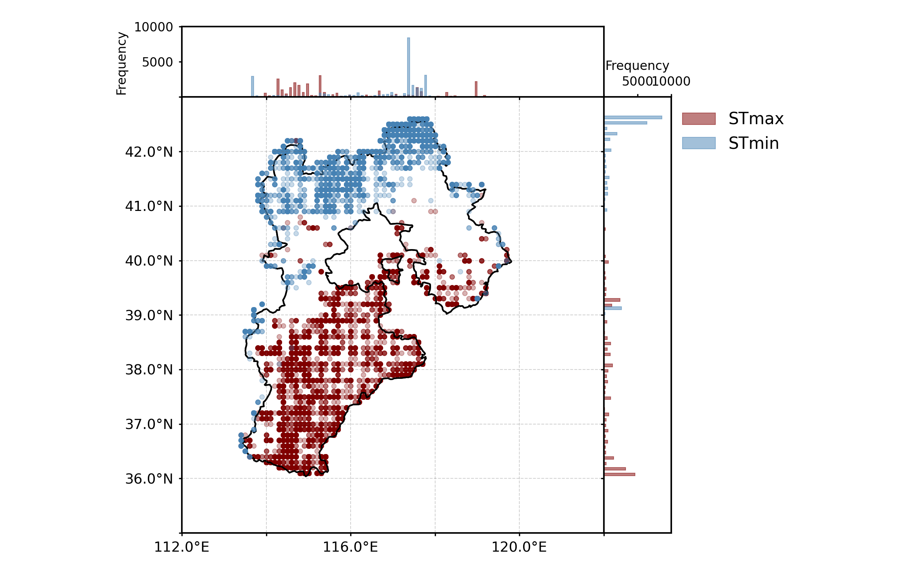
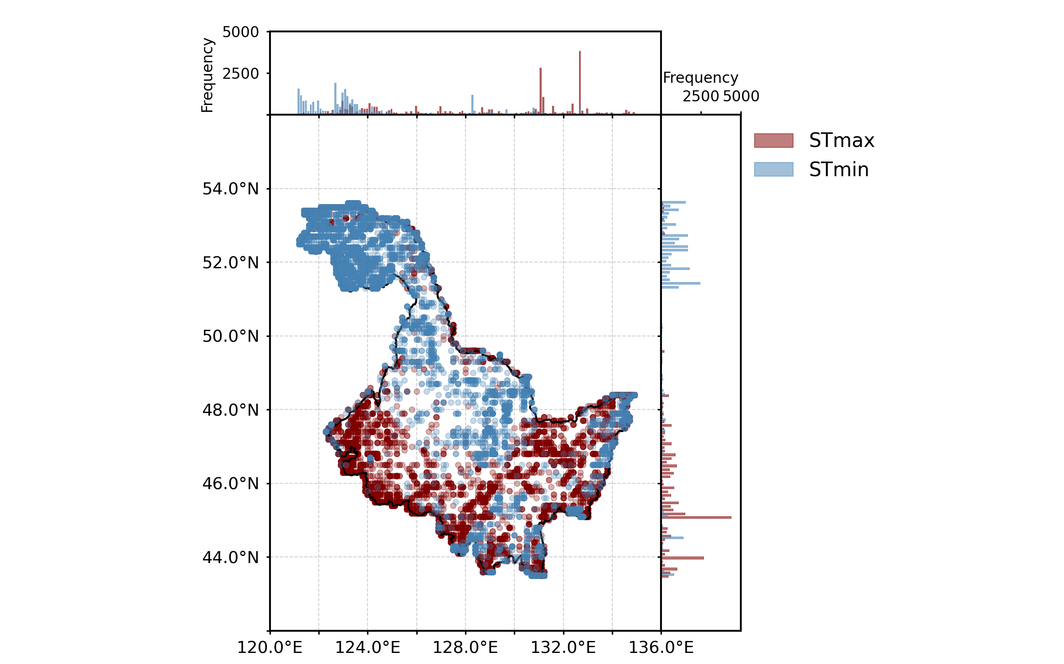
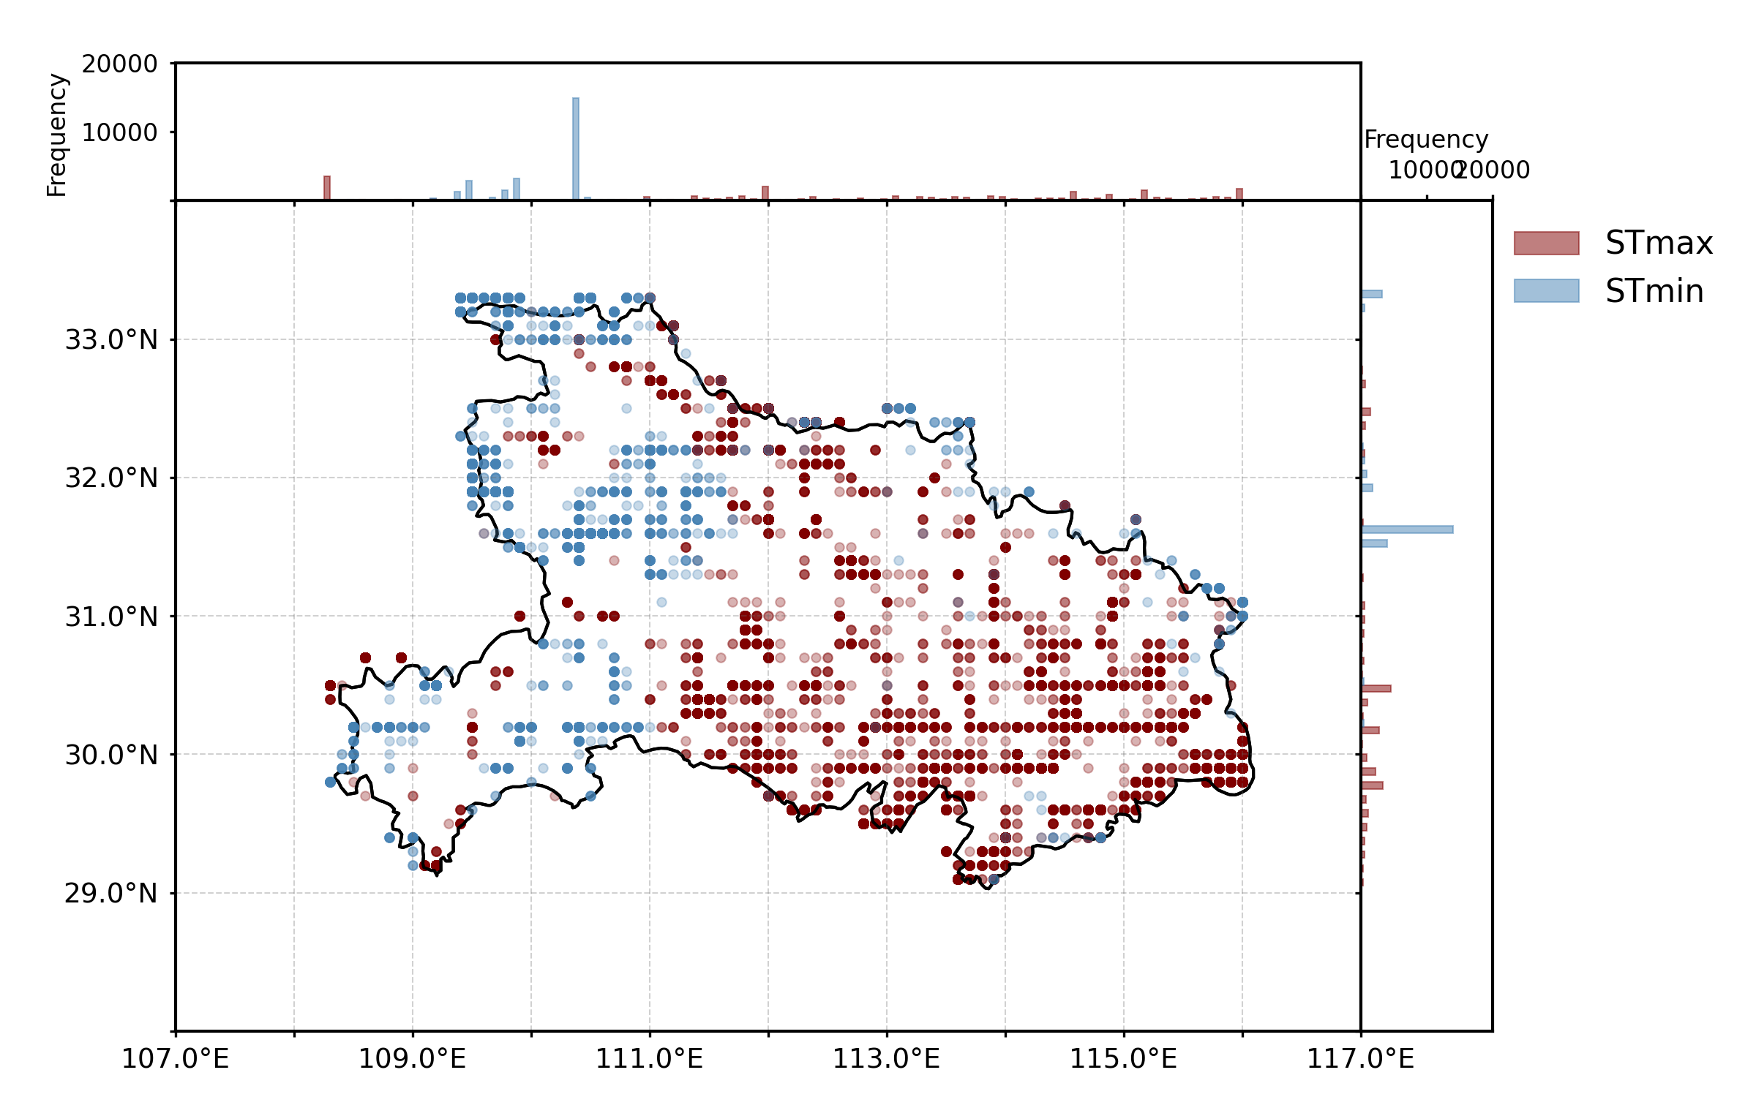
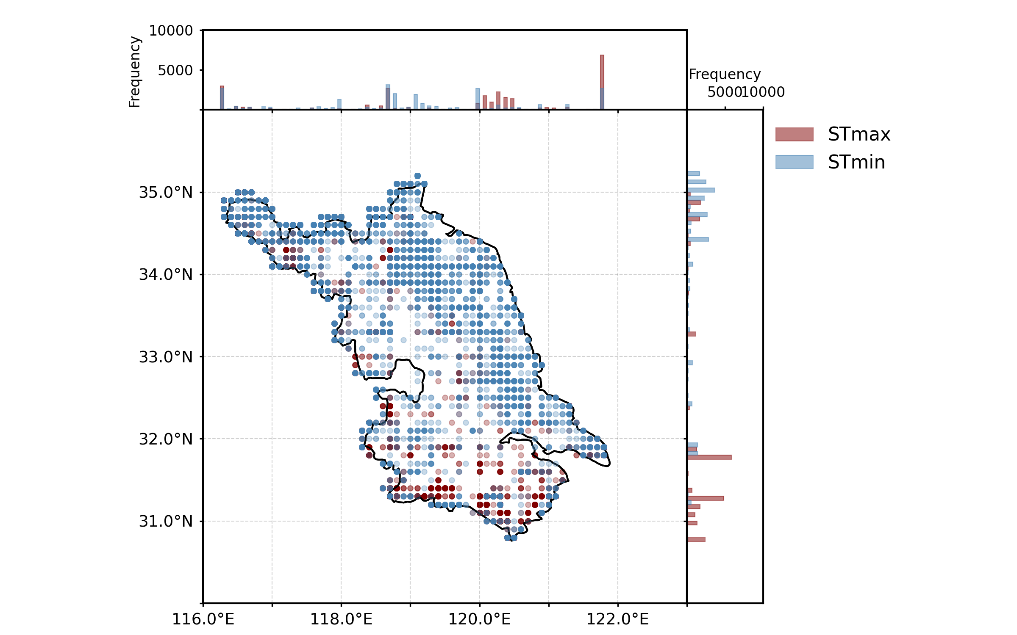
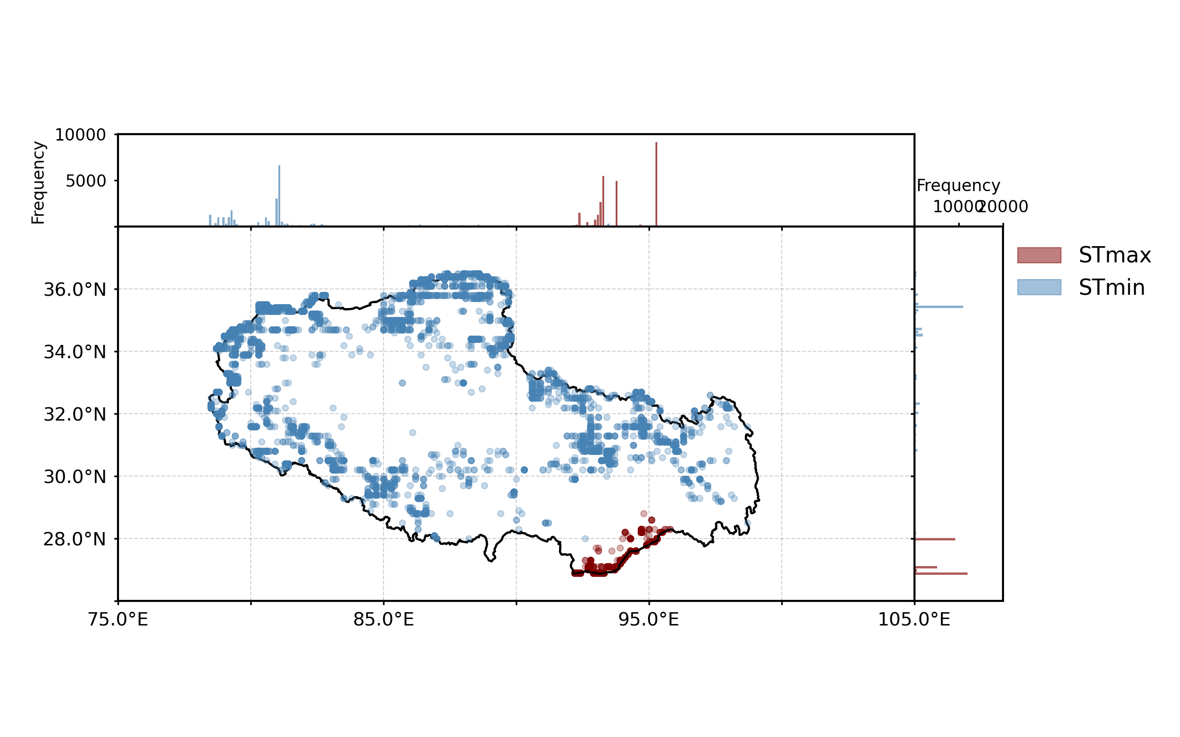
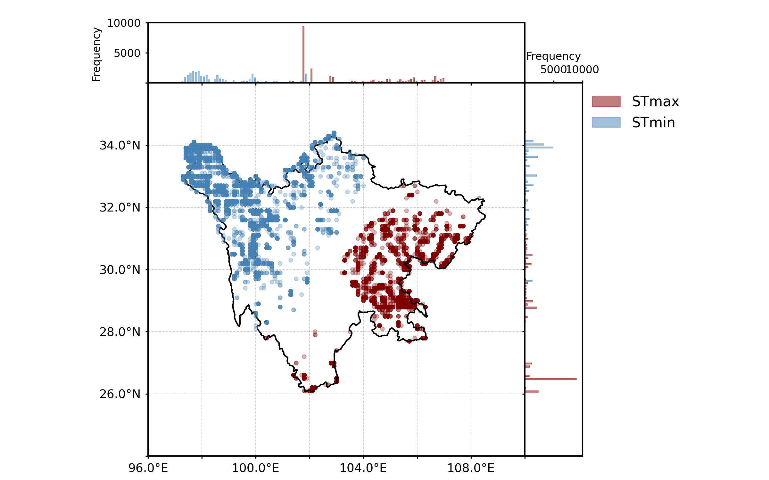
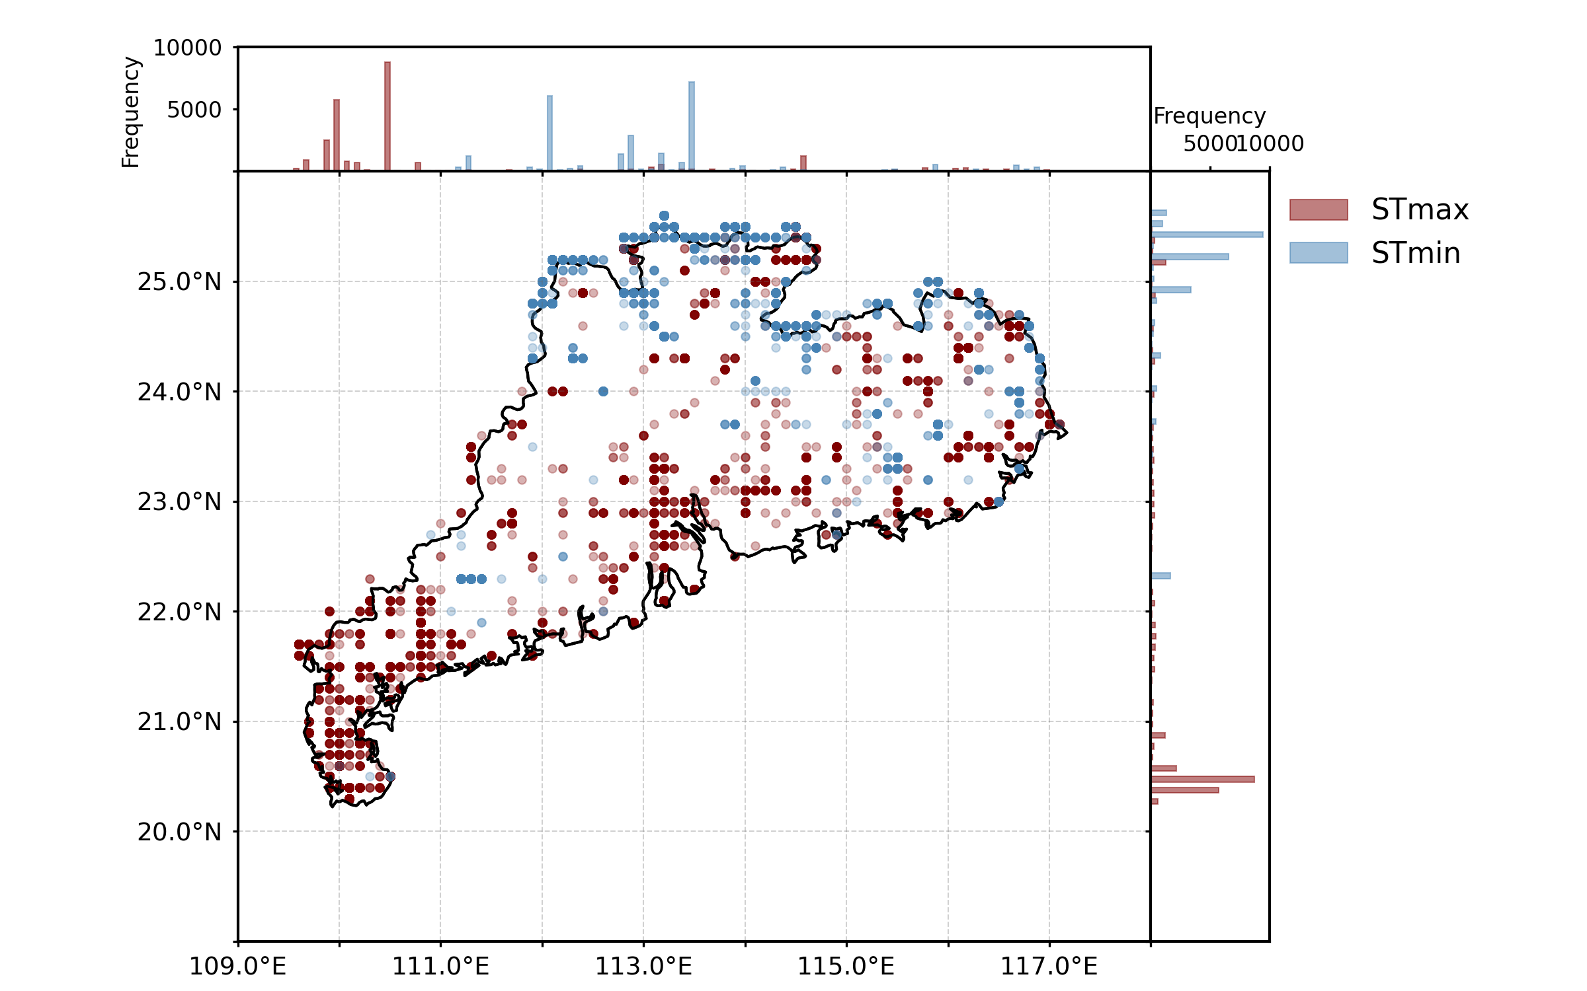
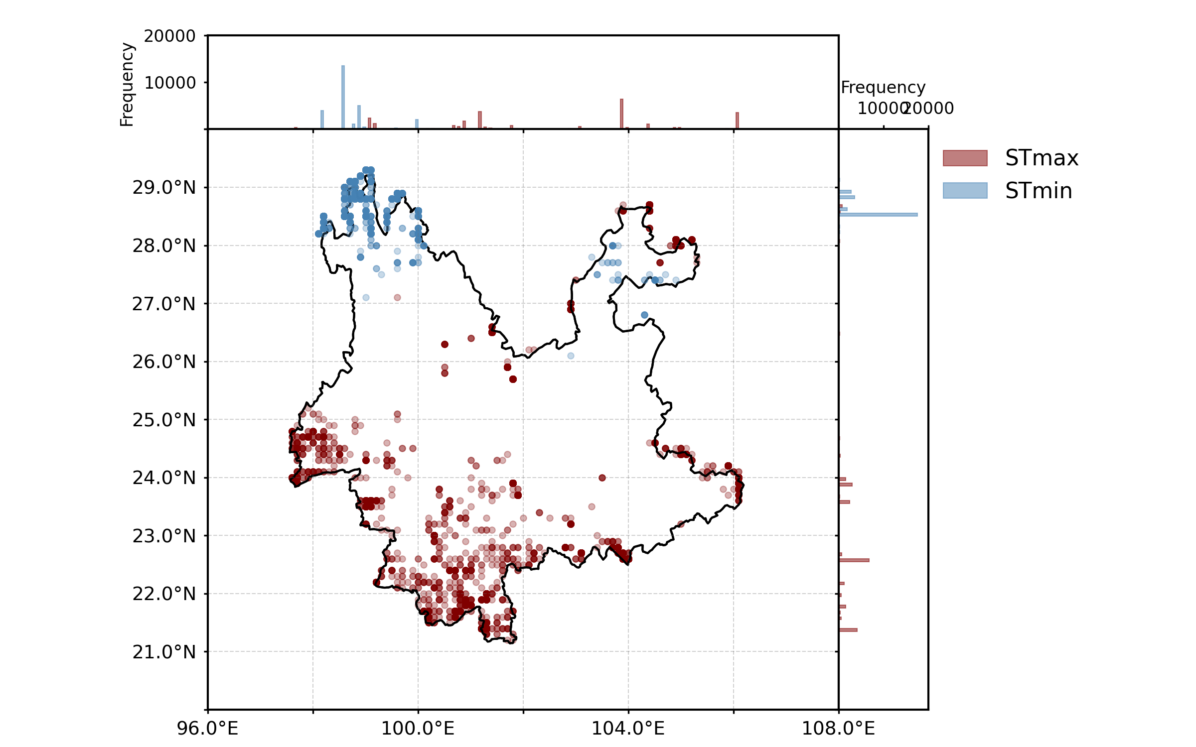
Fig. S3
Original
(a) Hebei
(b) Heilongjiang
(c) Hubei
(d) Jiangsu
(f) Sichuan
(e) Xizang
(g) Guangdong
(h) Yunnan

Slide 5
Fig. S3
Edited
(e) Xizang

Slide 6
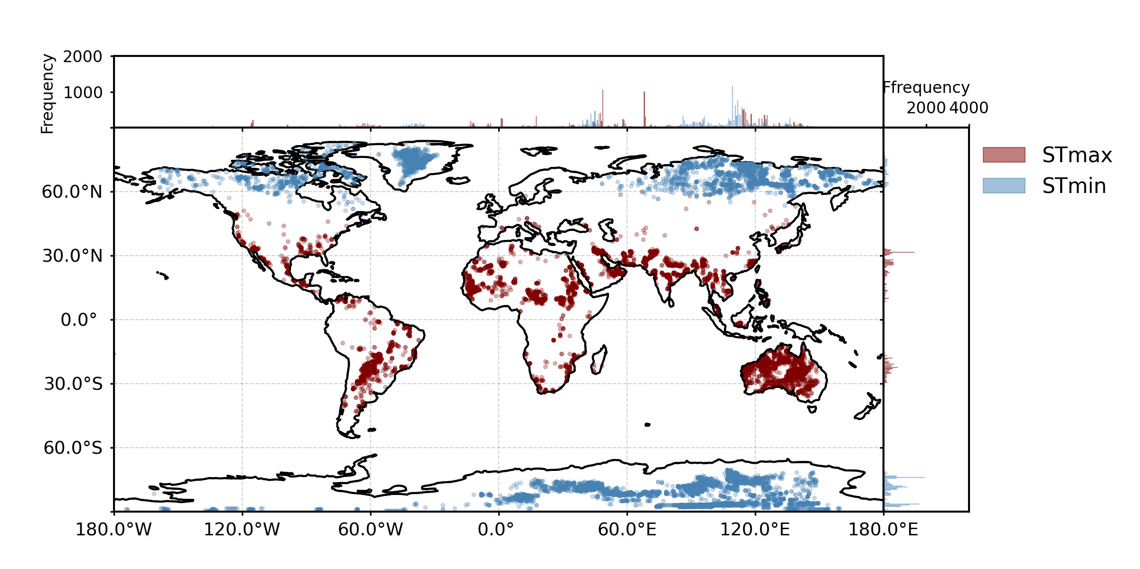
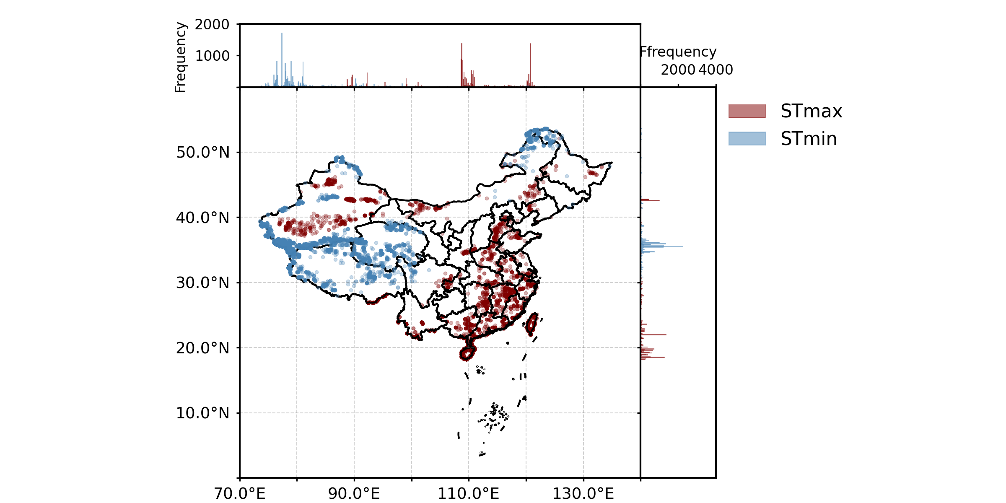
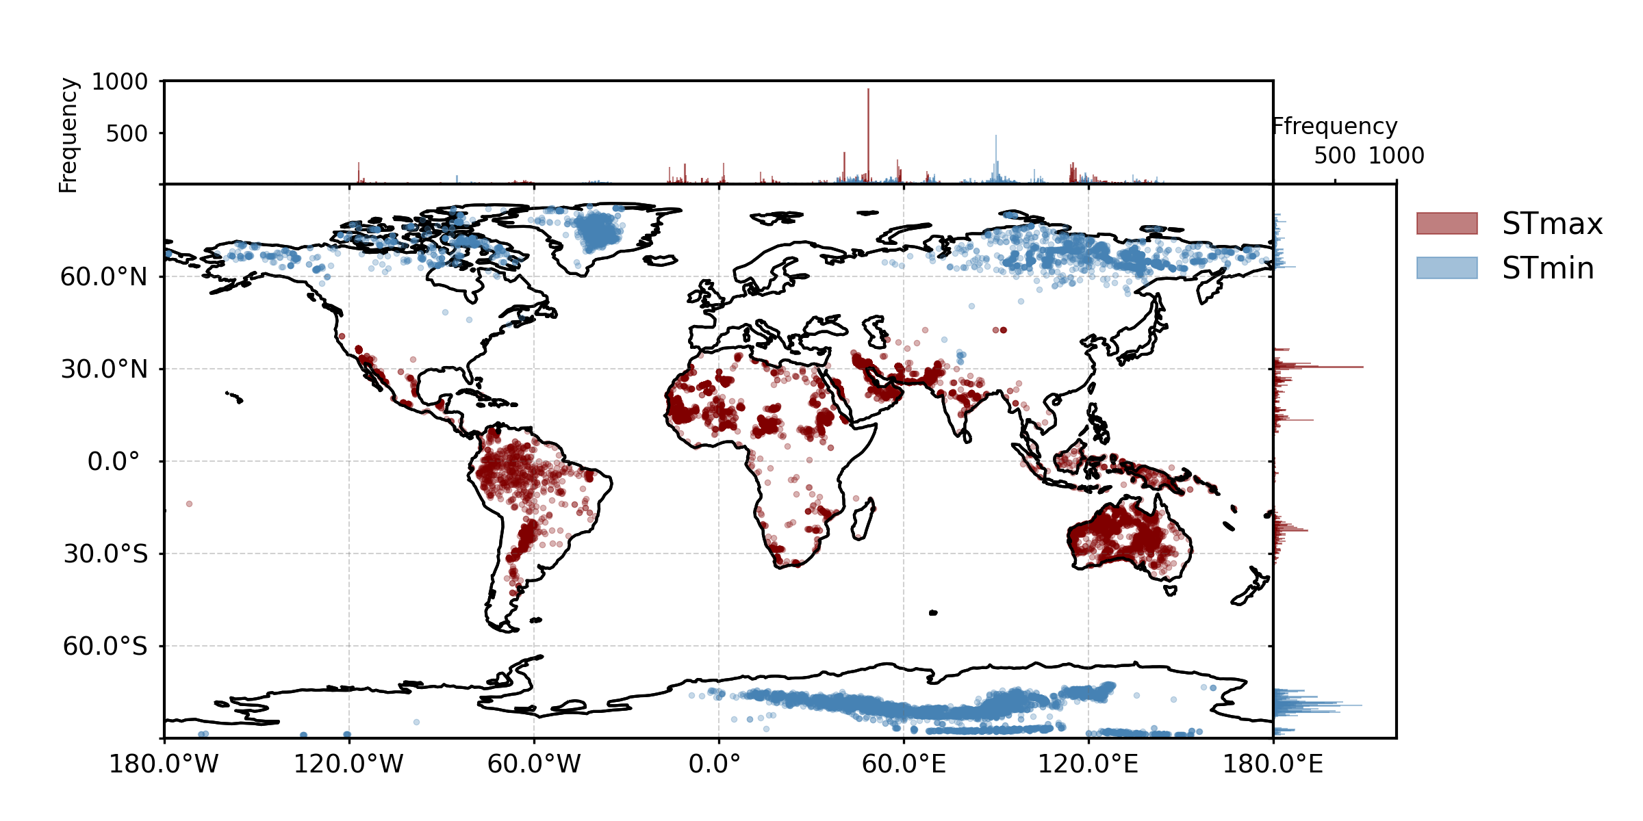
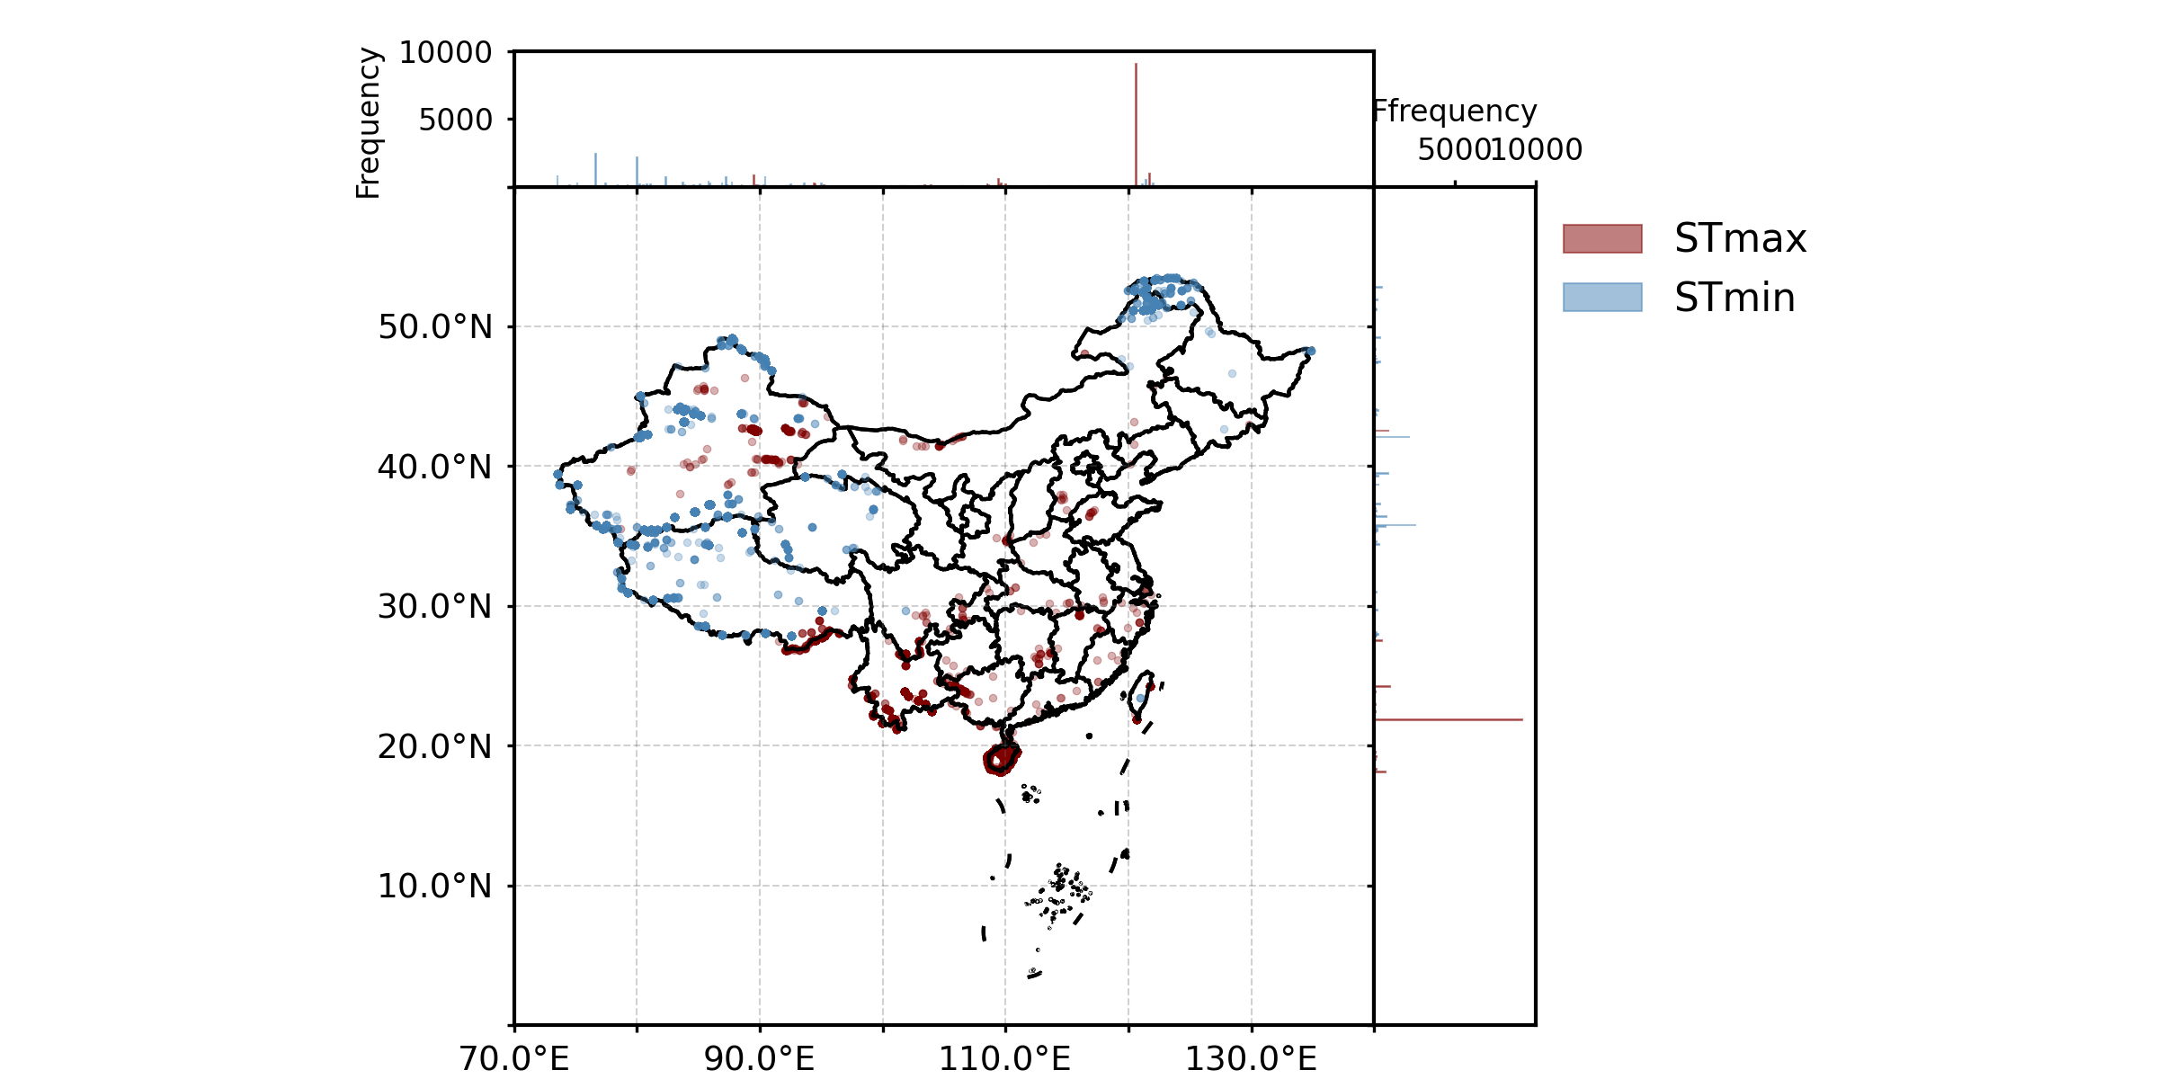
Fig. S4
Original
(b) ERA5-Land (1979-2018)
(a) ERA5-Land (1980-2023)
(c) MERRA2 (1980-2023)
(d) CMF (1979-2018)

Slide 7
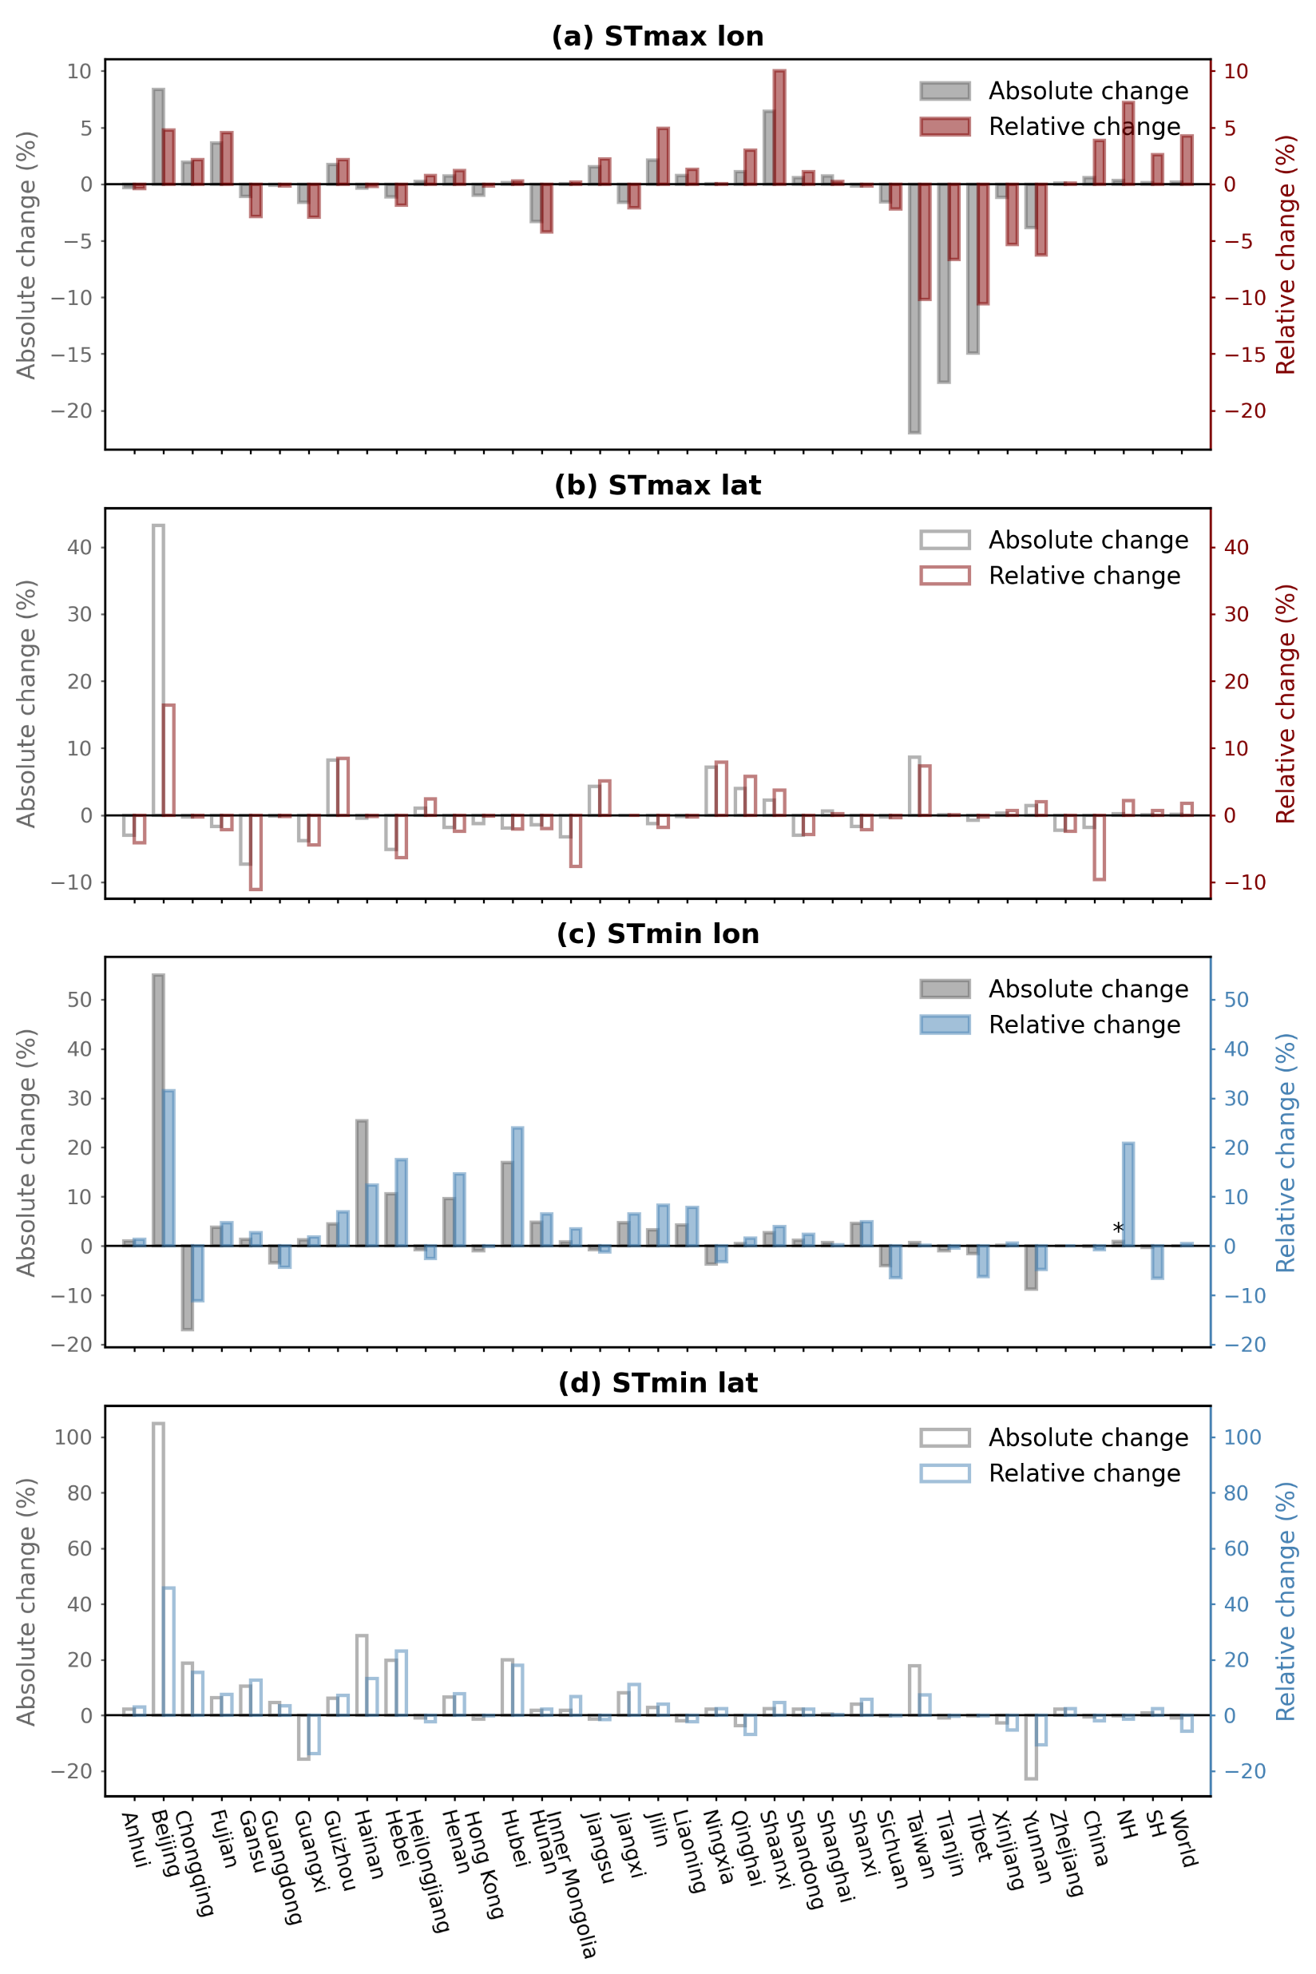
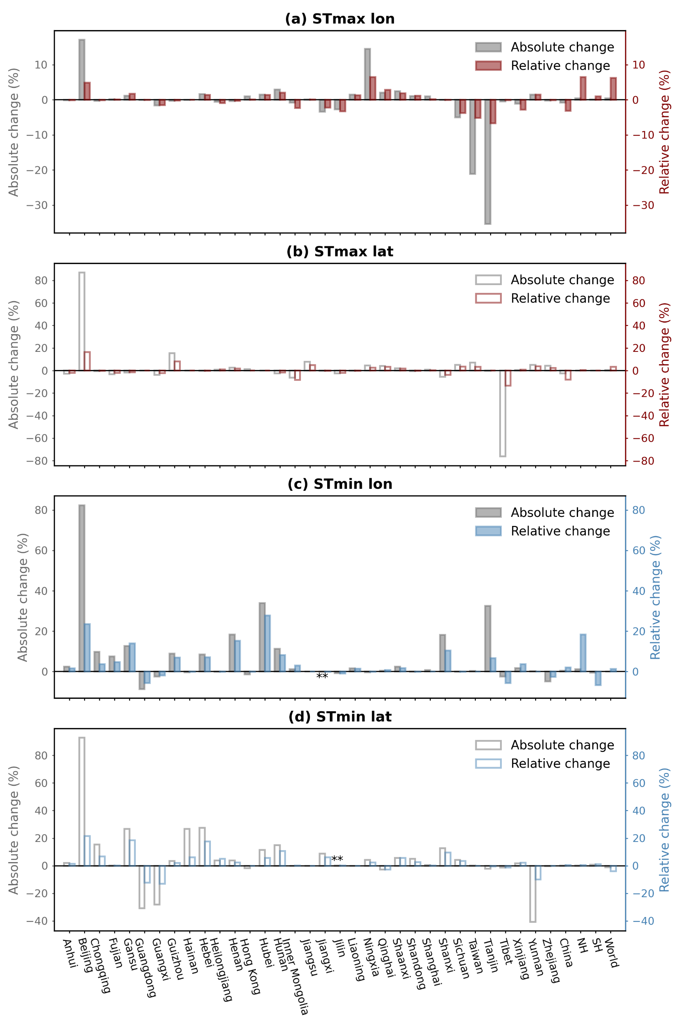
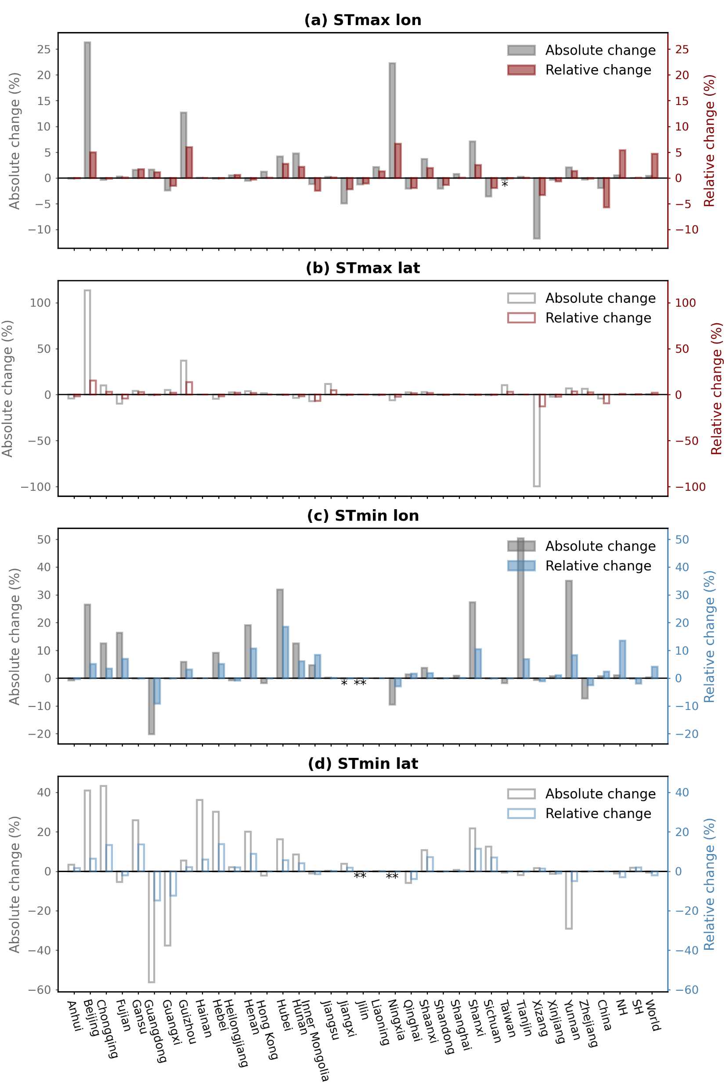
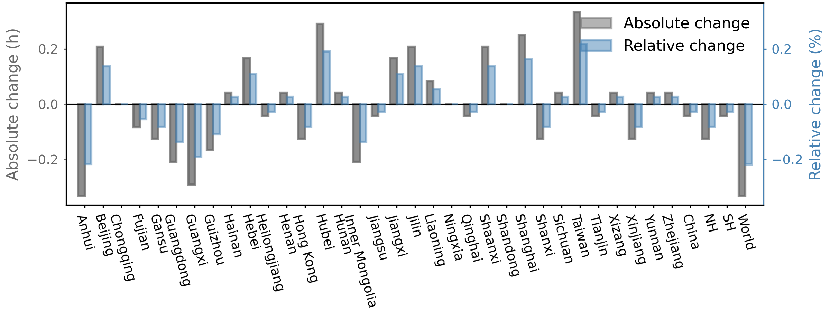
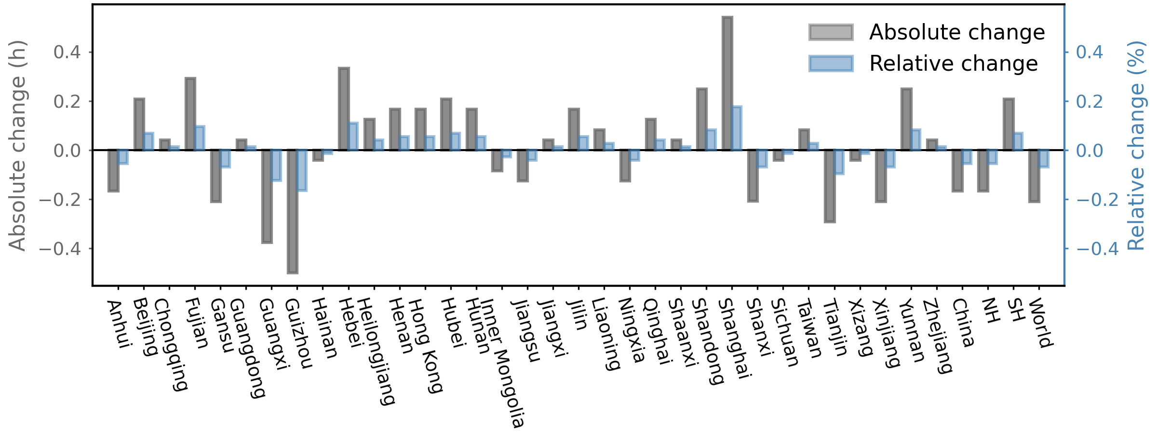
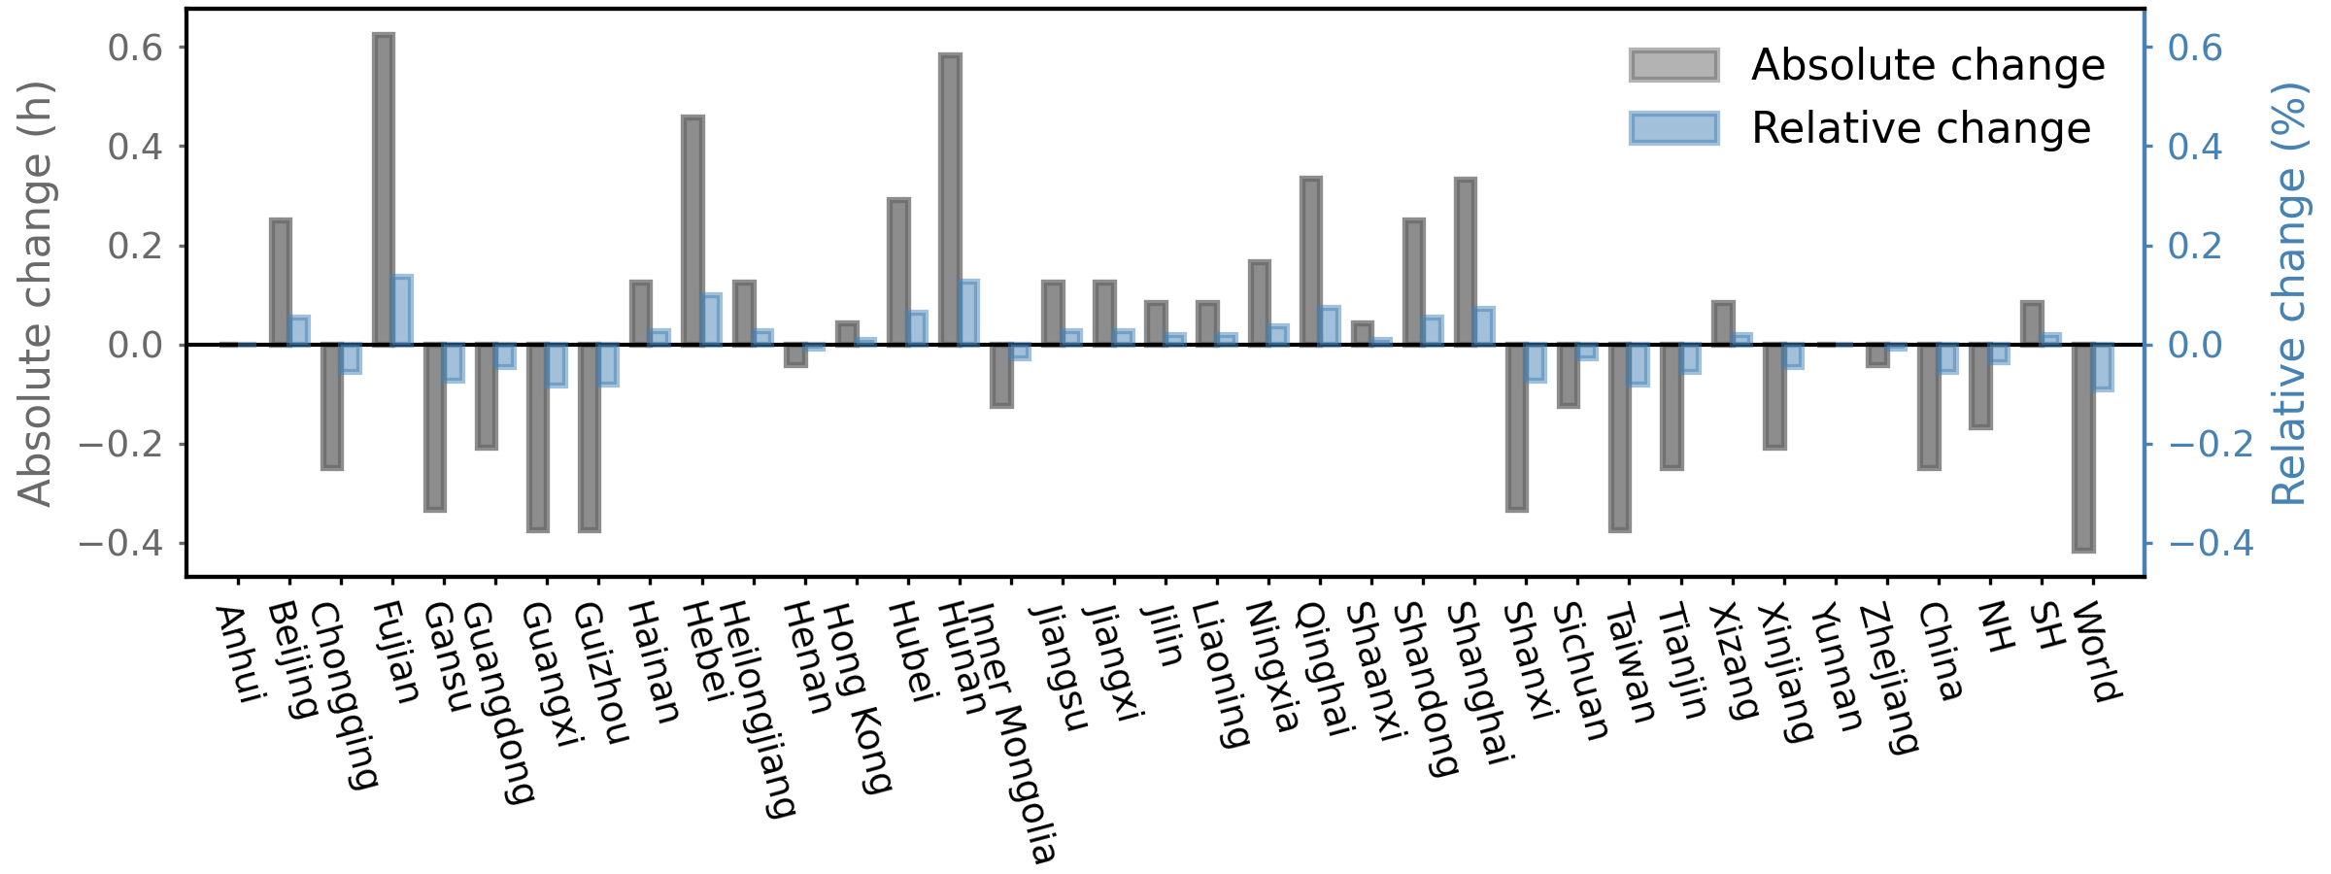
Fig. S5—S7
(e) Hourly distribution
(e) Hourly distribution
(e) Hourly distribution
1950-1959 V.S. 2014-2023
1950-1969 V.S. 2004-2023
1950-1979 V.S. 1994-2023

Slide 8
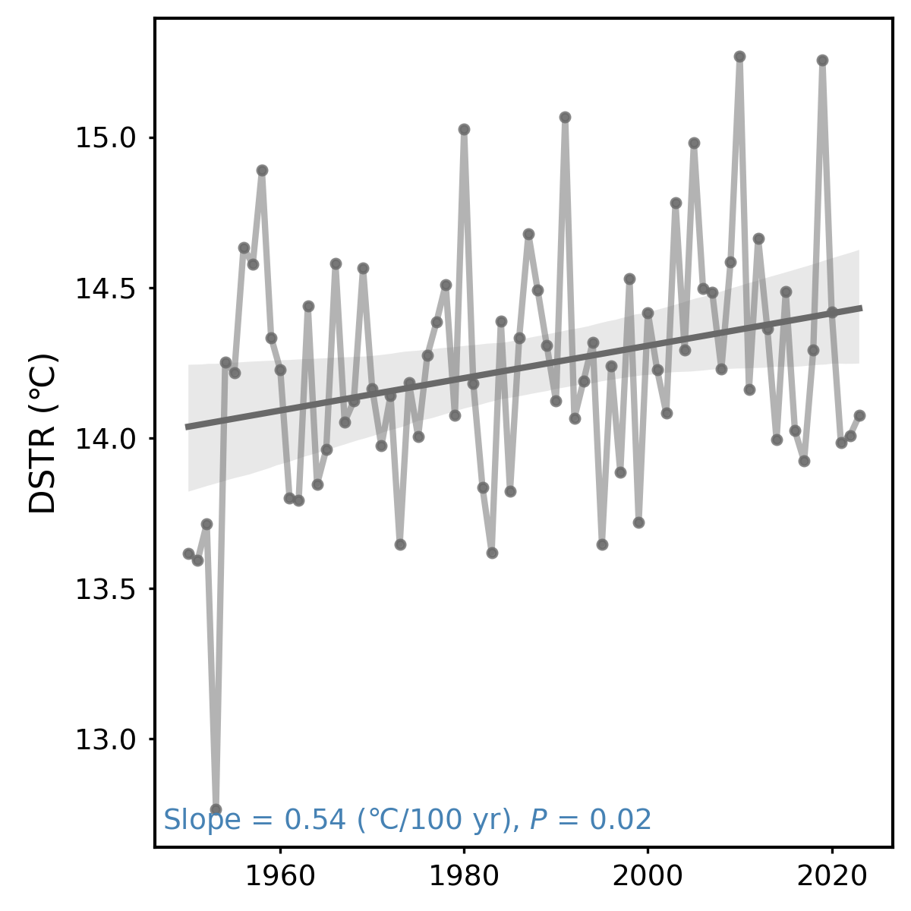
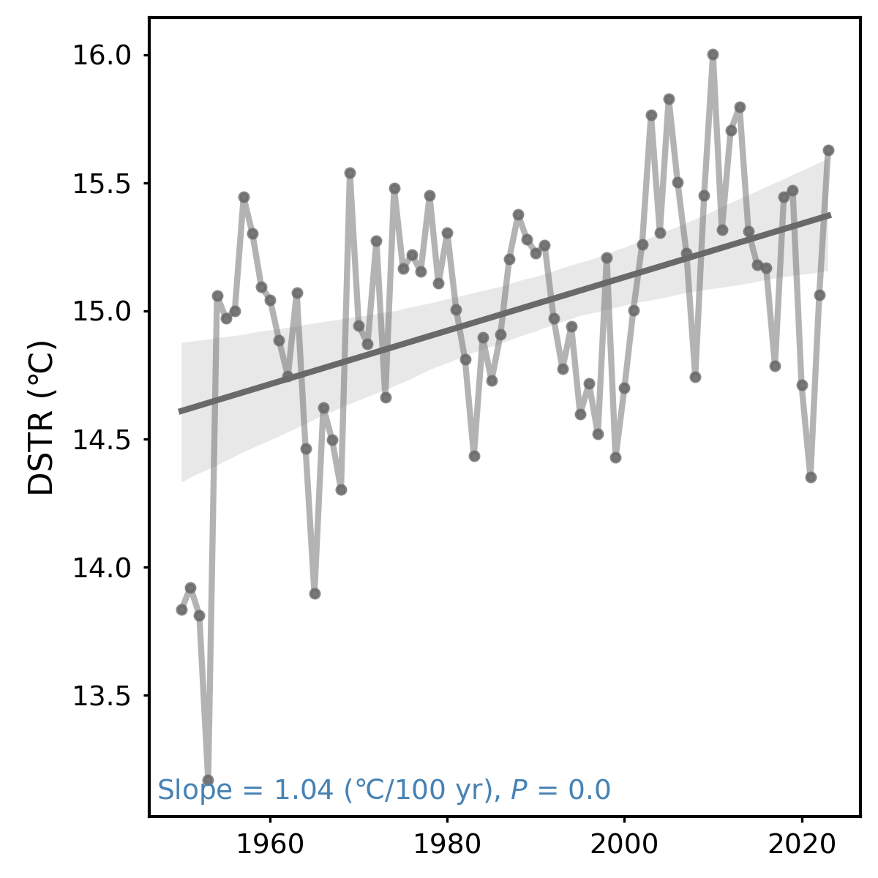
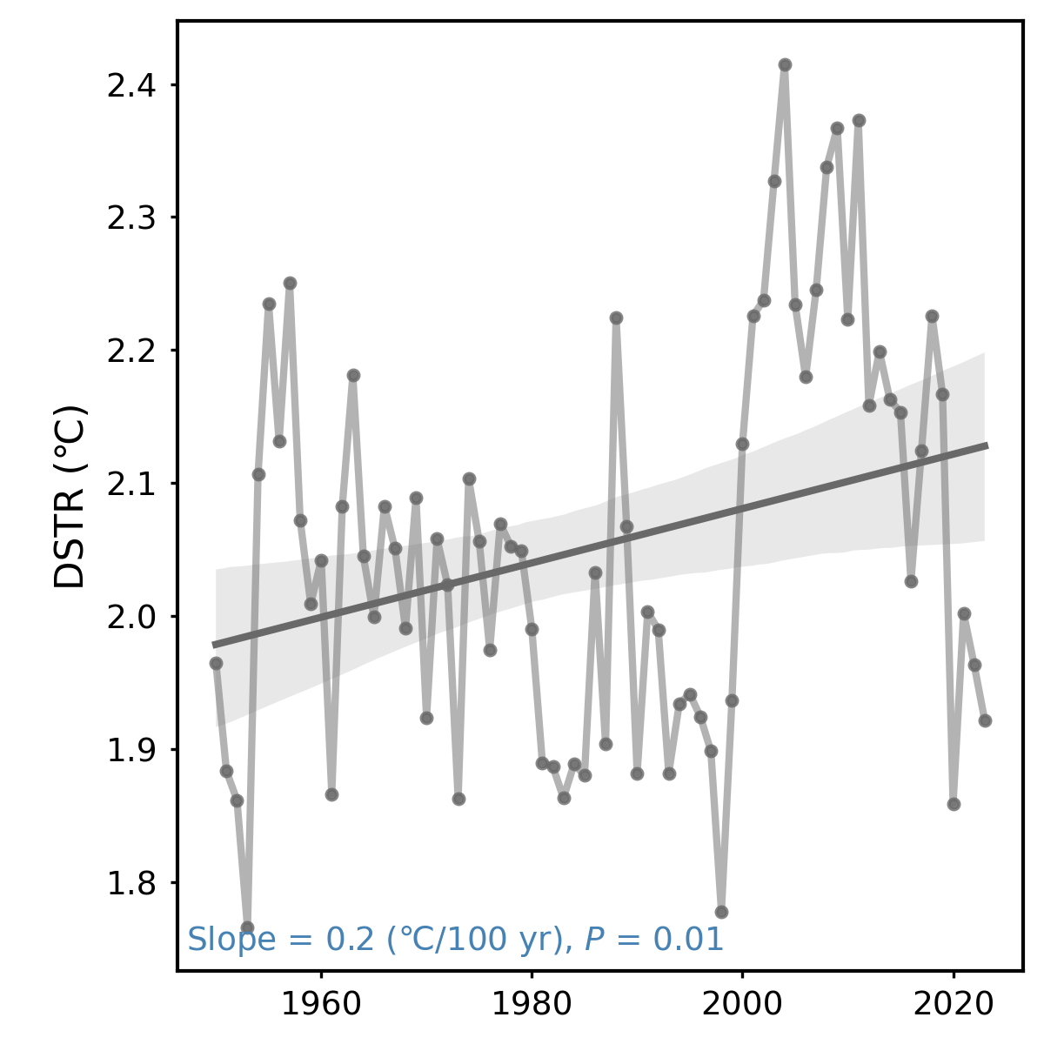
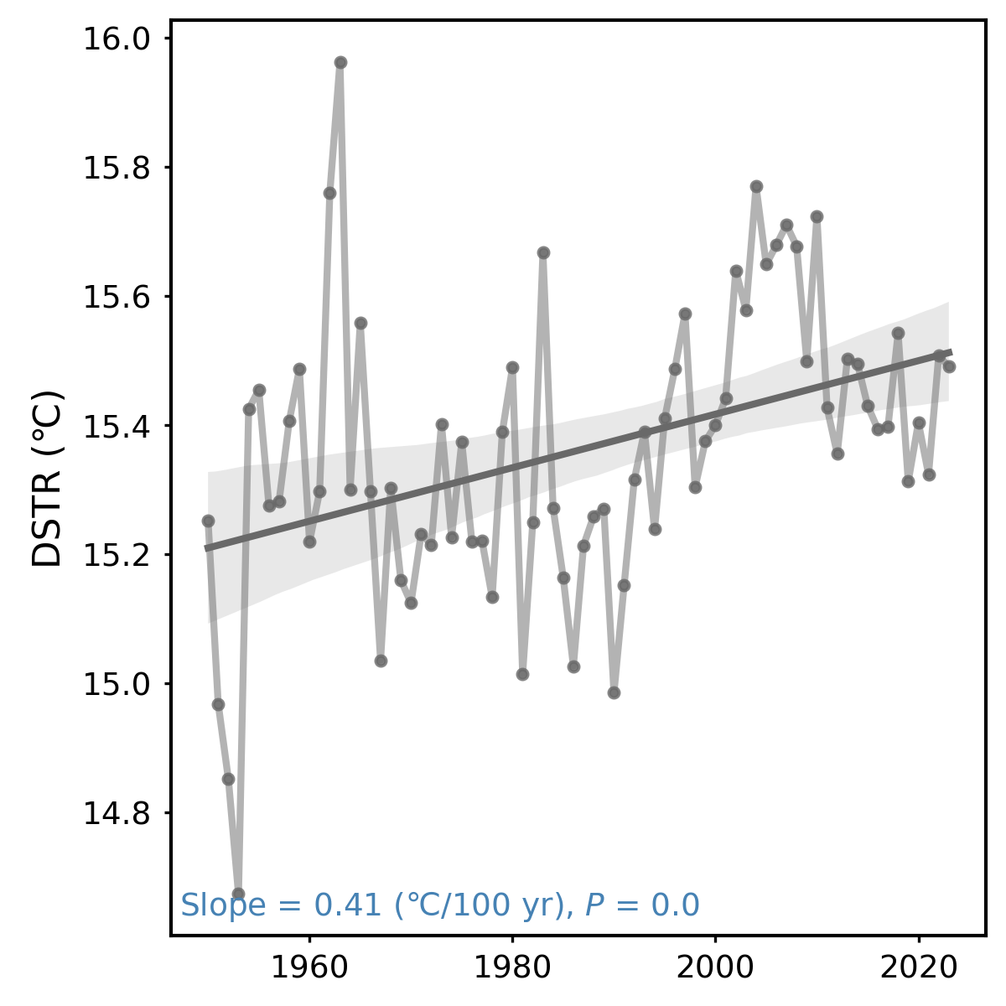
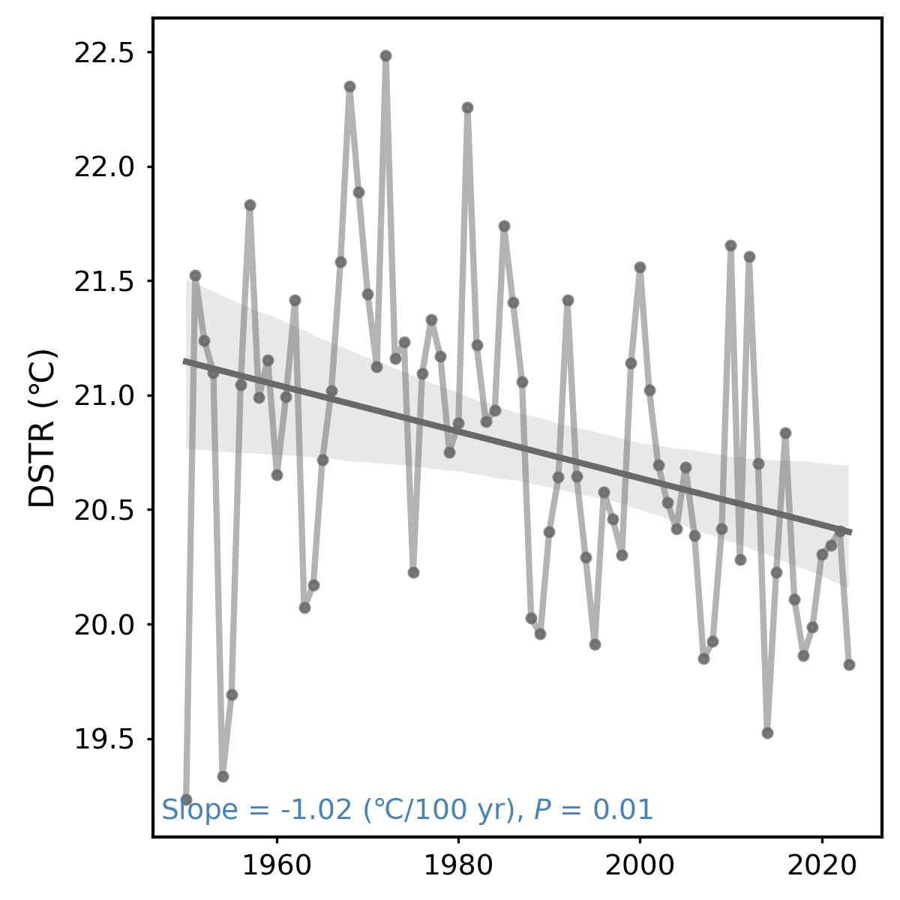
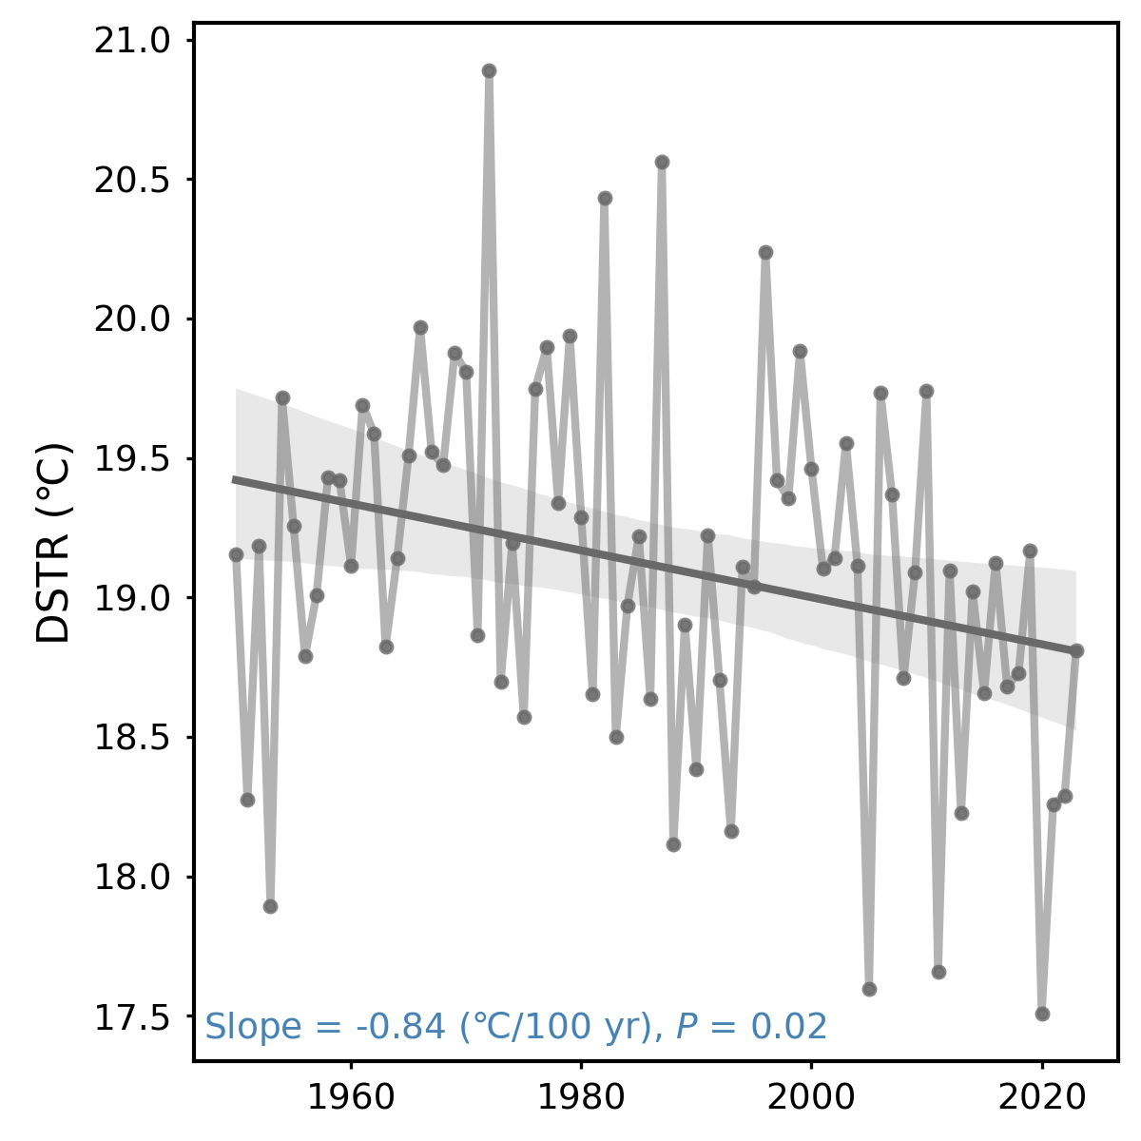
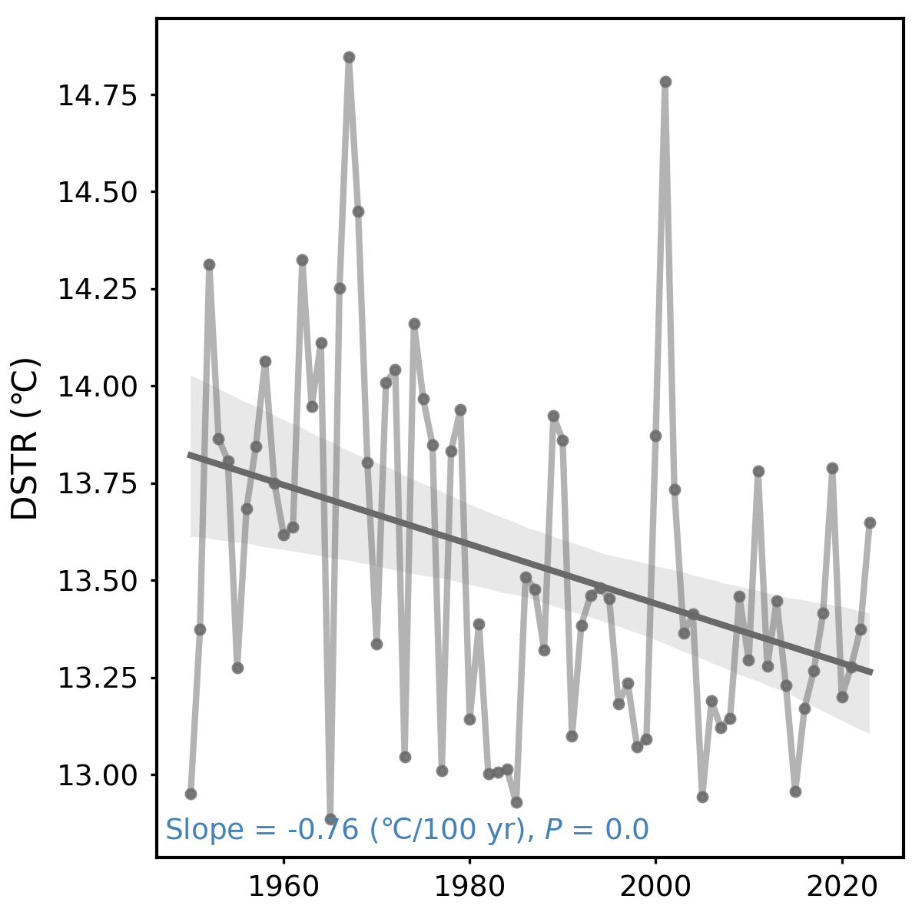
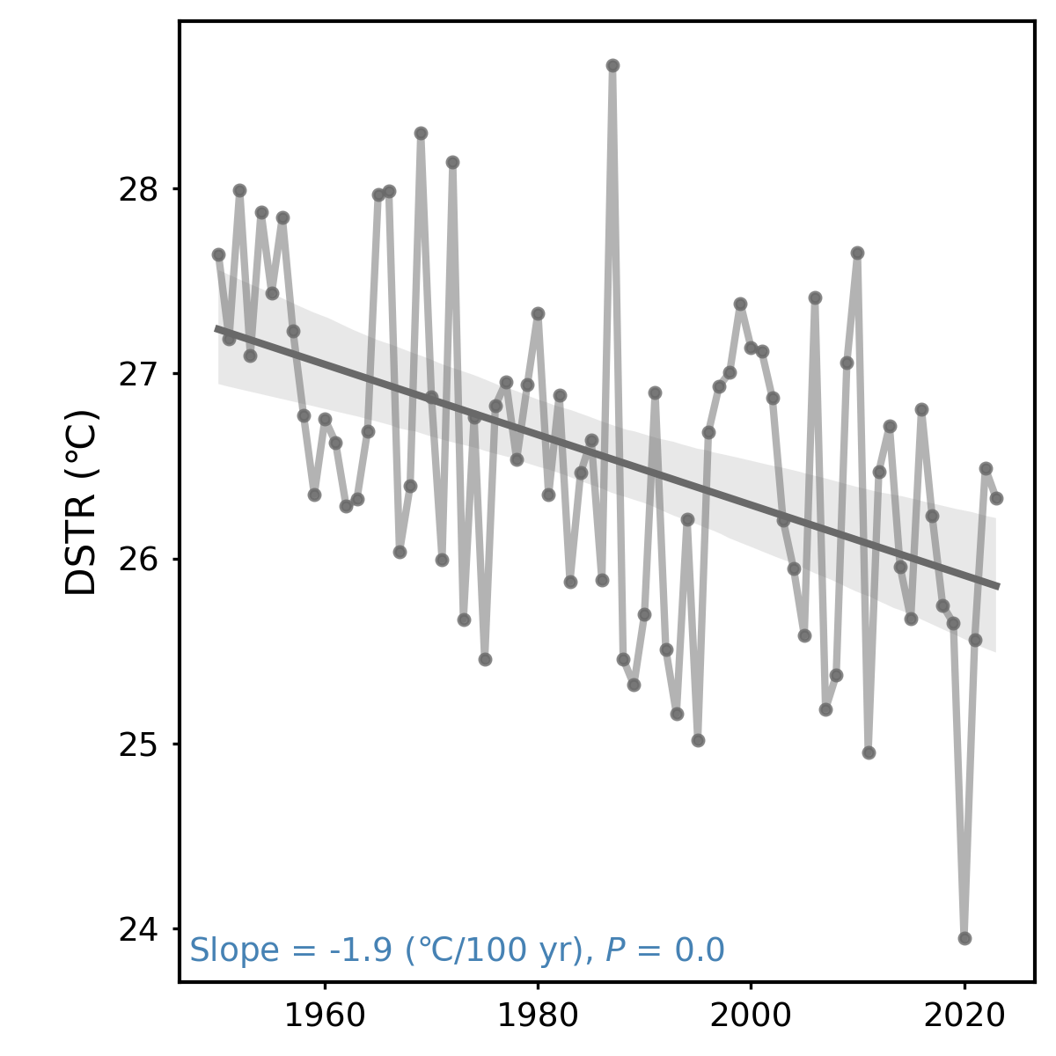
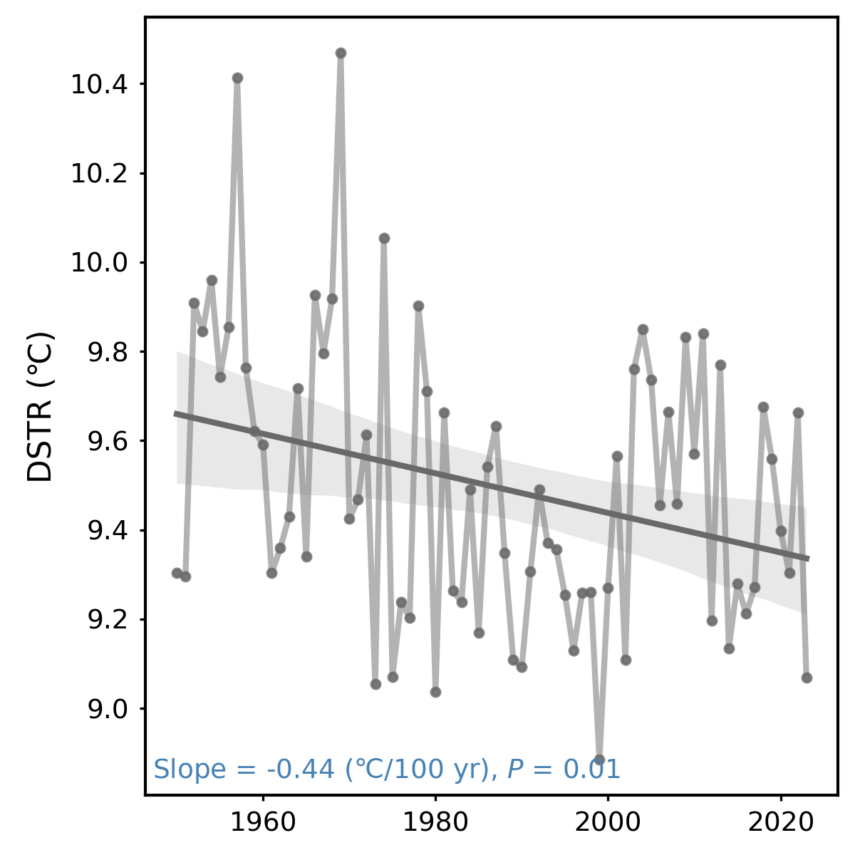
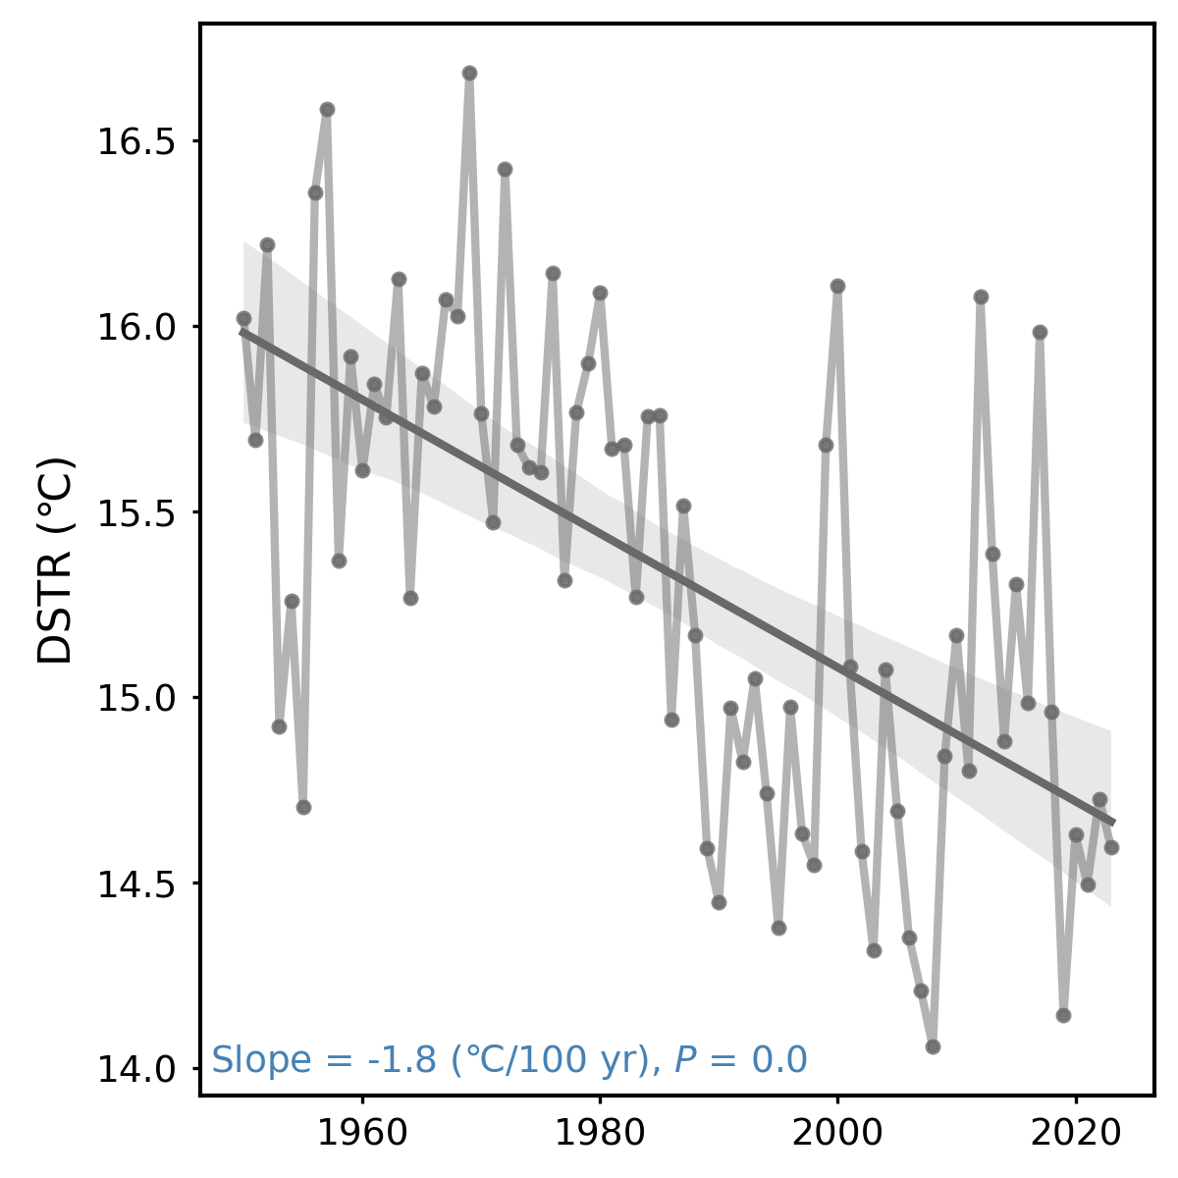
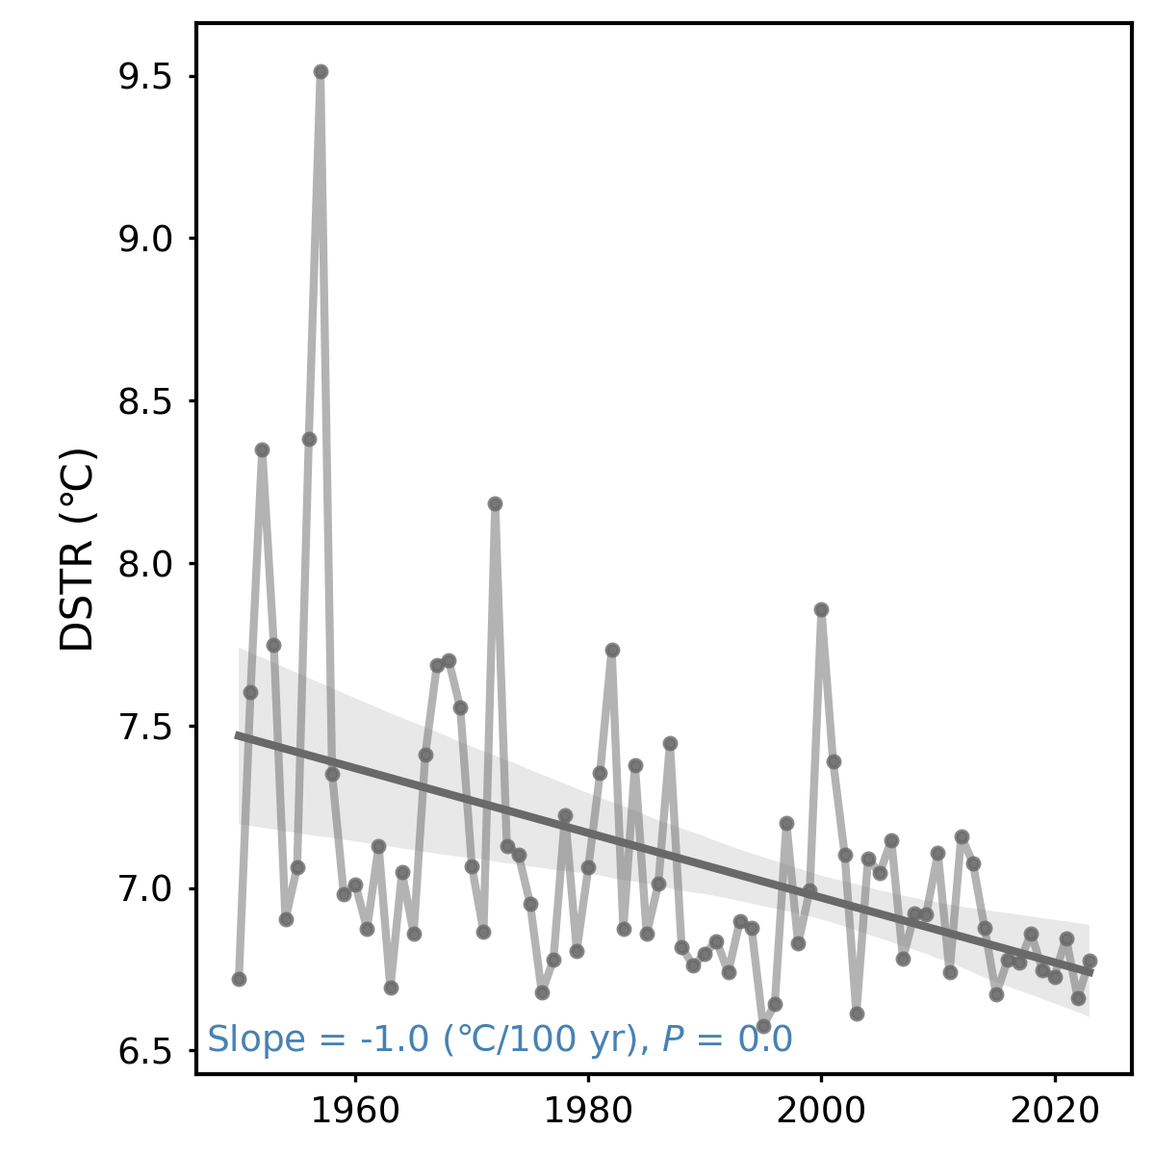
Fig. S9
(a) Guangxi
(b) Guizhou
(c) Hong Kong
(d) Taiwan
(e) Hebei
(f) Heilongjiang
(g) Henan
(h) Inner Mongolia
(i) Jiangsu
(j) Liaoning
(k) Tianjin

Slide 9
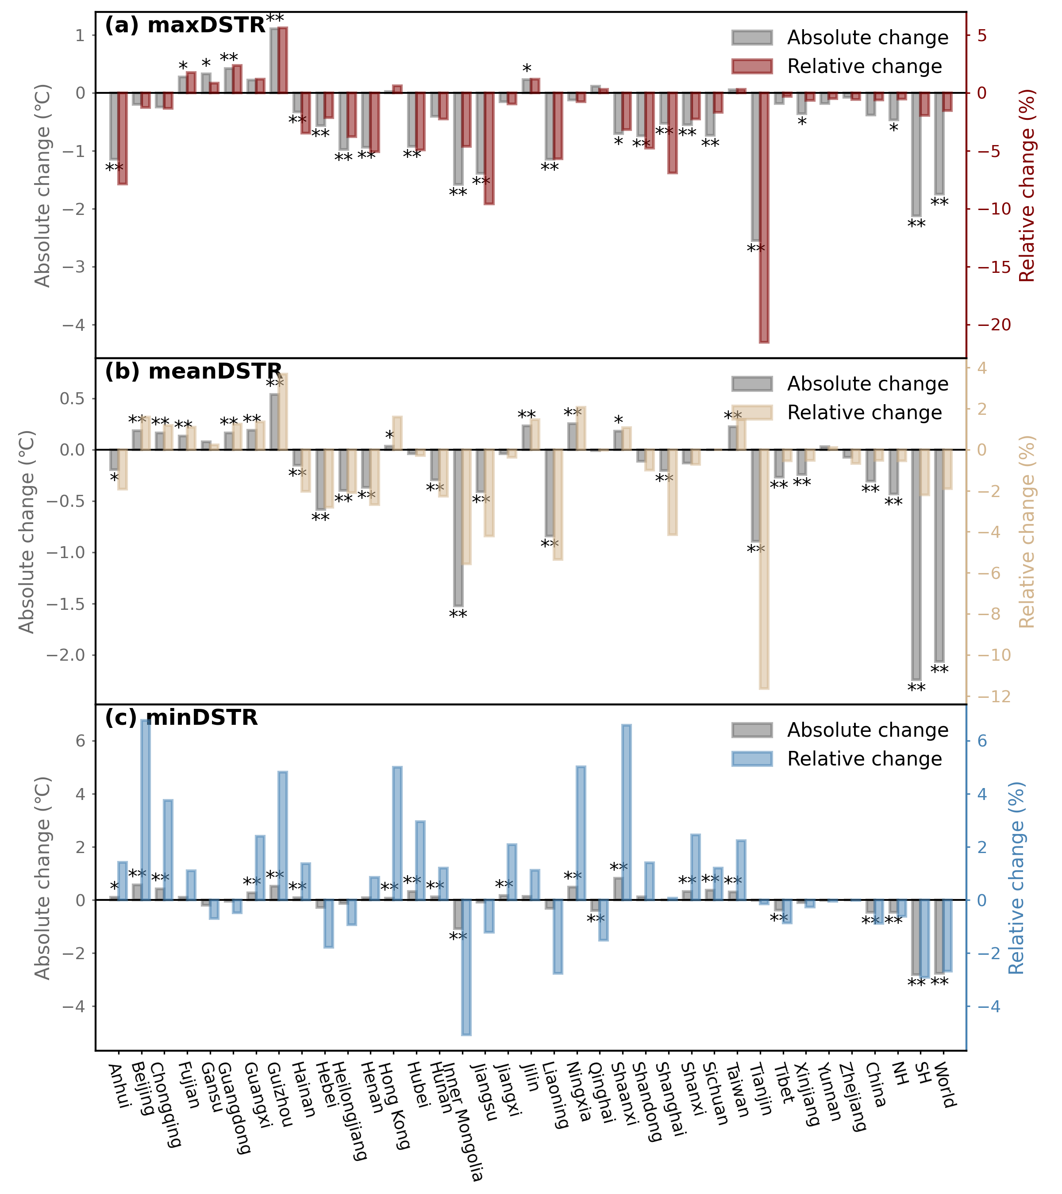
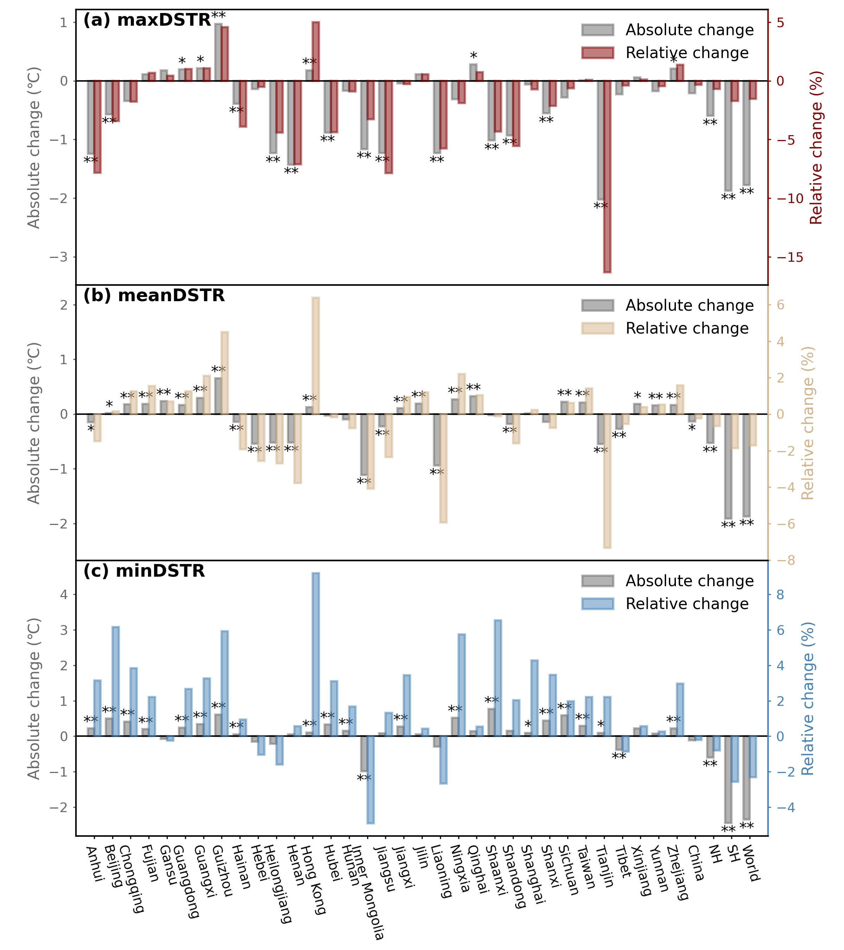
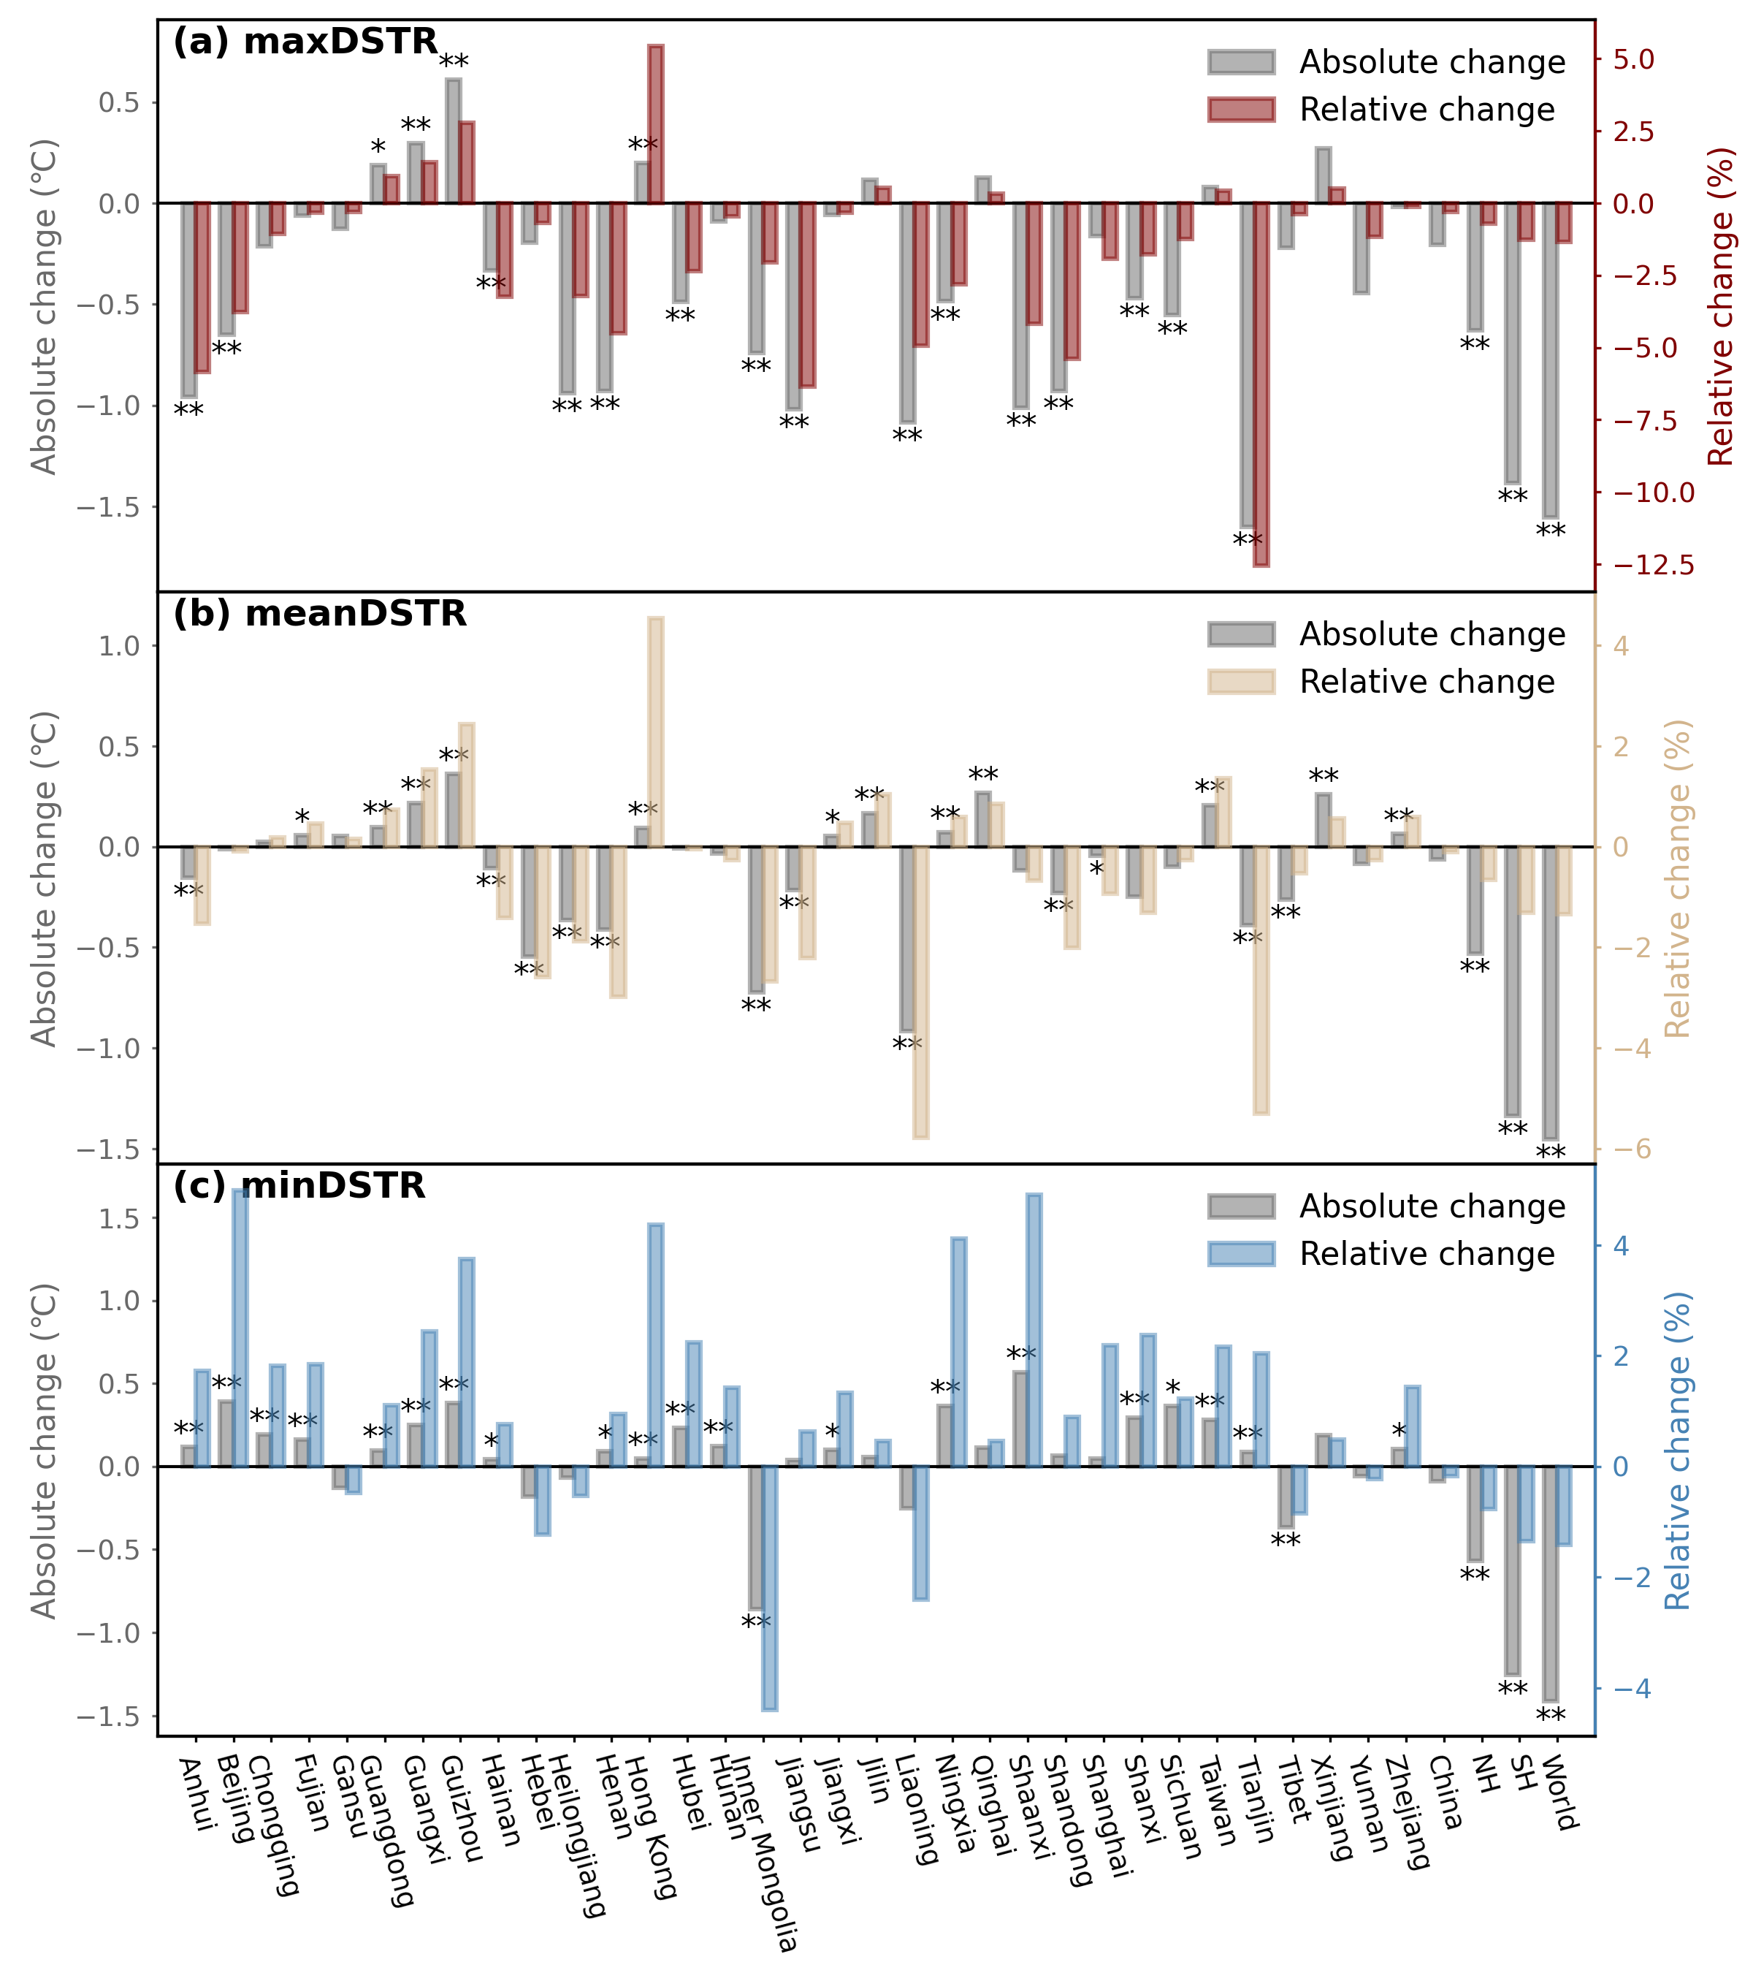
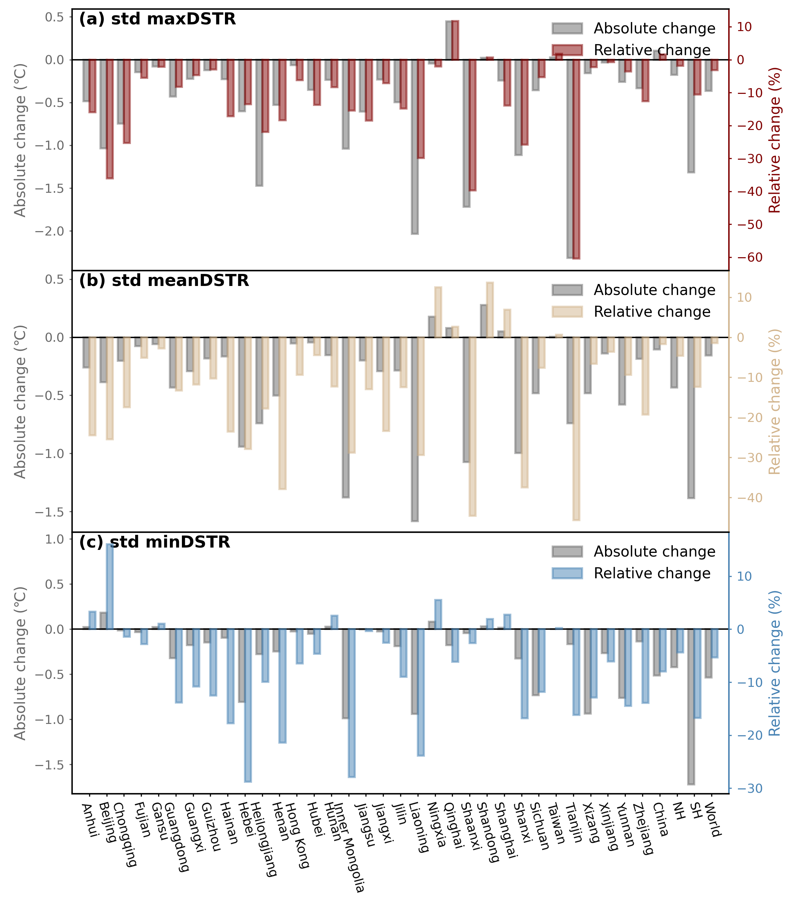
Fig. S10
(a) 1950-1959 V.S. 2014-2023
(b) 1950-1969 V.S. 2004-2023
(c) 1950-1979 V.S. 1994-2023

